Slide 1
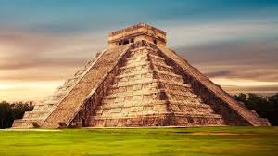
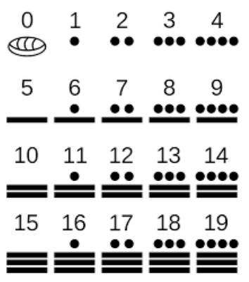
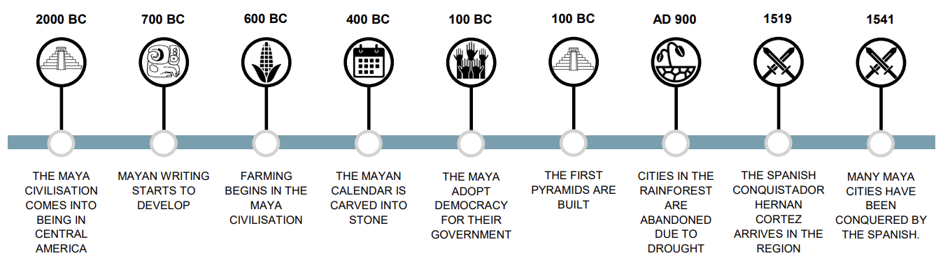
Ancient Maya | Diamond | History | Summer
What I should already know:
Many groups of people existed at the same time as other groups in history.
Ancient Egyptians had a writing system using hieroglyphics.
Ancient Egyptians built pyramids that were sacred tombs.
What I will learn:
LO 1: How did the Ancient Maya settle in a rainforest?
LO 2: How important was chocolate to the Ancient Maya?
LO 3: What did the Ancient Maya believe?
LO 4: How did the Maya reflect world beliefs in their inventions?
LO 5: What do archaeological remains tell us about Ancient Maya cities?
LO 6: What caused the decline of Ancient Maya cities?
Key Vocabulary:
deity | A synonym for god.
dynasty | A series of rulers or leaders who are all from the same family, or a period when a country is ruled by them.
maize | Corn – a major resource of food for Mayan people. Part of their religious culture too.
Mesoamerica | A historical region and cultural area in North America. It extends from approximately central Mexico through Belize, Guatemala, El Salvador, Honduras, Nicaragua, and northern Costa Rica.
rituals | A religious or solemn ceremony
sacrifice | An act of slaughtering an animal or person or surrendering a possession as an offering to a deity (ruler or god)
temple | A building used for the worship of a god or gods in some religions.
Significant People:
Kinich Ahau God of the Sun Hun Hunahpu God of Maize Chaac God of the Rain
K'inich Pakal. Ruled from 615-683 AD. Whom we know today as Pakal the Great. He was king of Palenque (in modern Mexico). The name Pakal means shield in classic Maya language.

