Slide 1
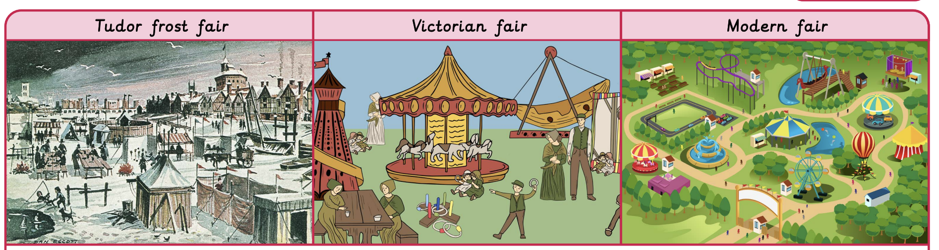
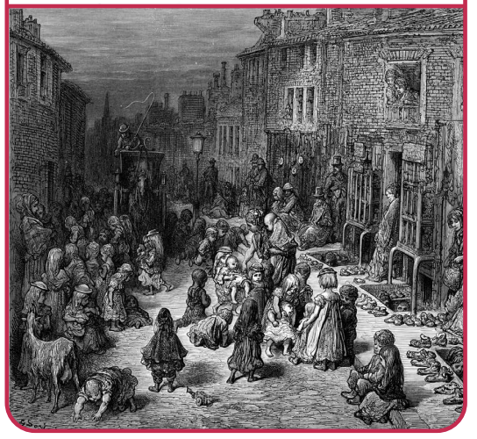
How have children’s lives changed? | Diamond | History | Spring
What I should already know:
How to place events in chronological order.
The influence a group of people can have on a country.
The similarities and differences between the ways of life in another period.
What I will learn:
LO 1: What do sources tell us about how children’s lives have changed?
LO 2: Why did Tudor children work and what was it like?
LO 3: What were children’s jobs like in Victorian England?
LO 4: How did Lord Shaftsbury help to change the lives of children?
LO 5: How and why has children’s leisure time changed?
LO 6: What were the diseases children caught and how were they treated?
Key Vocabulary:
apprentice | A young person who learns a trade or occupation in return for accommodation, clothing and food
disease | illnesses, many of which were very dangerous (for example, cholera, smallpox and typhoid).
childhood | the time between infancy and adolescence.
continuity | things that remain the same.
deduction | conclusions reached after looking at sources.
poverty | having little money to pay for accommodation, food, heating or clothing.
servant | a member of staff who kept the house clean and looked after the family.
working conditions | the environment in which people work, including safety, hours and pay.
Significant People:
Lord Shaftsbury (1801-1885) A British, social reformer who encouraged the establishment of schools to give working children an education. He also highlighted the poor working conditions for children and reduced their working hours.

