Slide 1
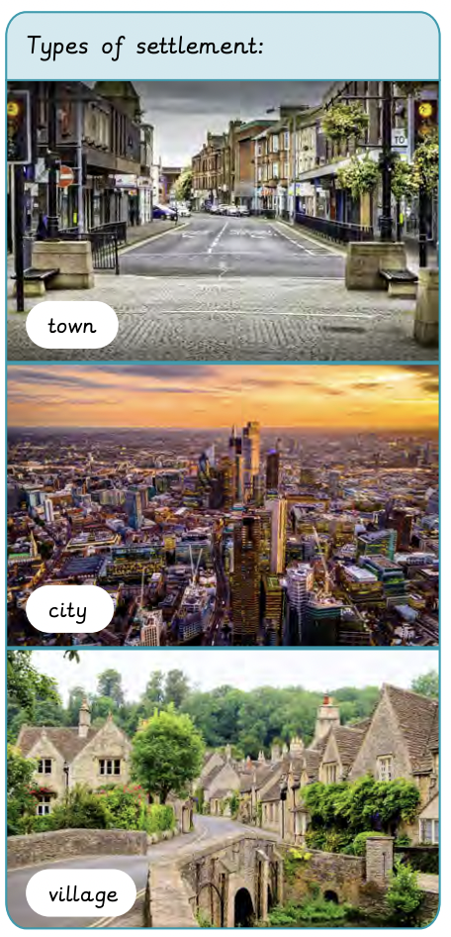
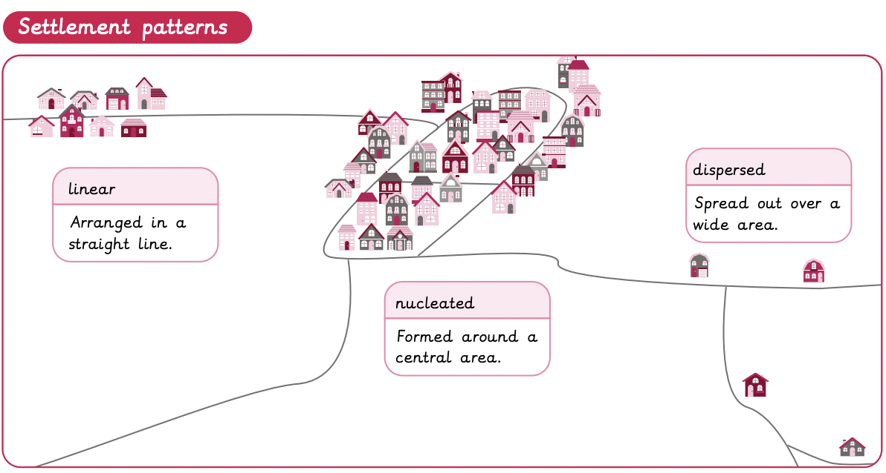
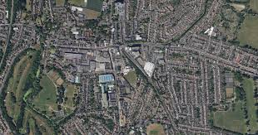
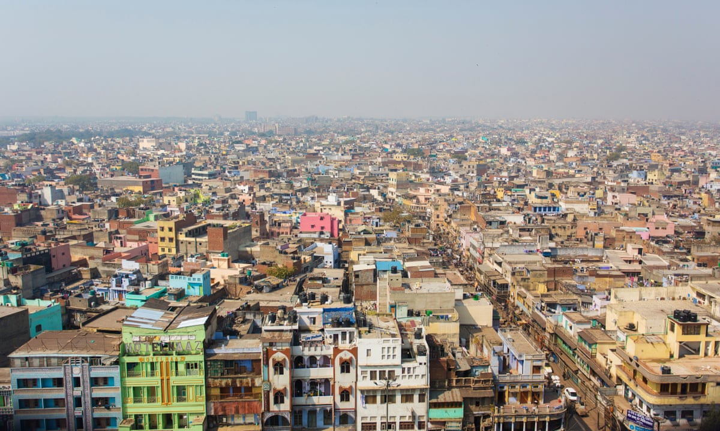
Are all settlements the same? | Diamond | Geography | Spring
What I should already know:
The names and locations of the countries and capital cities in the United Kingdom.
How human and physical geography influence each other.
The area in which I go to school and where I live.
What I will learn:
LO 1: What is a settlement?
LO 2: How is land used in my local area?
LO 3: Can I explain the features in my local area?
LO 4: How has my local area changed over time?
LO 5: How is land used in New Delhi?
LO 6: How does land use in New Delhi compare with my local area?
Key Vocabulary:
agricultural land | Land that is used for farming, raising crops, and animals.
border | A line that separates geographic areas, such as countries or states.
capital city | A city where a country's government is based.
commercial land | Land use for buildings aimed at making money.
county | A term used to refer to different areas usually consisting of various towns and villages.
dispersed | Settlements where buildings are spaced across a wide area.
facilities | Places where certain things happen. For example, schools for education or parks for playing
linear | A group of buildings that are arranged in a long line.
nucleated | A circular settlement where buildings are grouped together.
residential land | Land used for housing and apartment blocks.
recreational land | Land which has buildings providing fun activities.
transportation | Land used as a way of getting something from one place to another.

