Slide 1
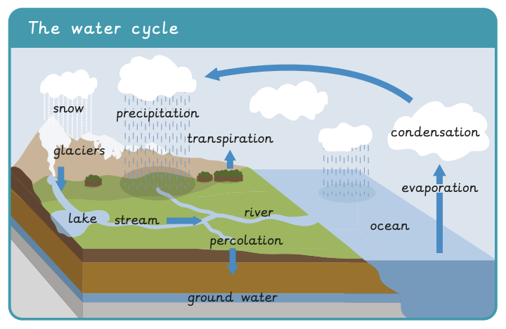
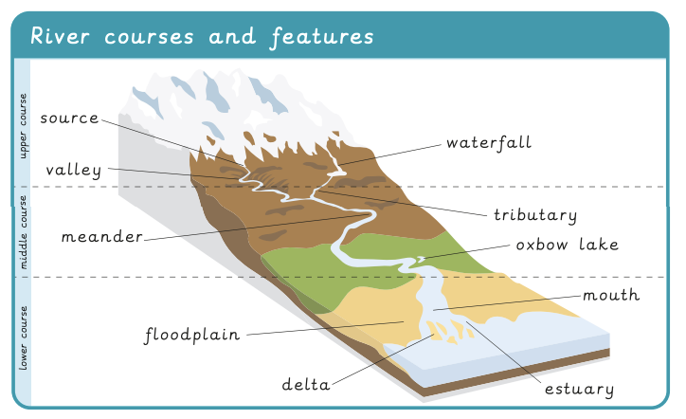
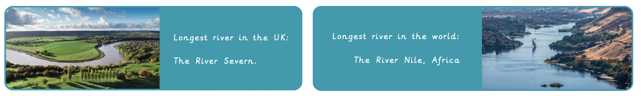
What are rivers and how are they used? | Diamond | Geography | Summer
What I should already know:
The names and locations of the continents
The name of the county they live in and their closest city
The main types of land use.
The features of an OS map and what they are used for
What I will learn:
LO 1: What is the water cycle?
LO 2: How is a river formed?
LO 3: Where can we find rivers?
LO 4: How are rivers used?
LO 5: What can we find out about our local river?
LO 6: What features does our local river have?
Key Vocabulary:
evaporation | Warm water turns from a liquid into a gas (water vapour)
condensation | Water vapour rises in the air, cools down and turns into small water droplets
precipitation | Water falls from clouds to the ground, in the form of rain, sleet, snow or hail
delta | A wide area near where a river meets the sea which forms a build-up of sand and sediment
estuary | The area where fresh water from a river meets salt water from the sea
floodplain | Areas of flat land on either side of a river that can become flooded if the river gets too full
meander | A bend or curve in a river
oxbow lake | A bend in the river that has been separated from the main river
river mouth | The place where a river flows into the sea
source | The place where a river starts
tributary | A stream that flows into a larger stream or river
valley | An area of low land between two hills or mountains, usually with a river running through it

