Slide 1
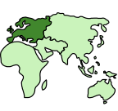

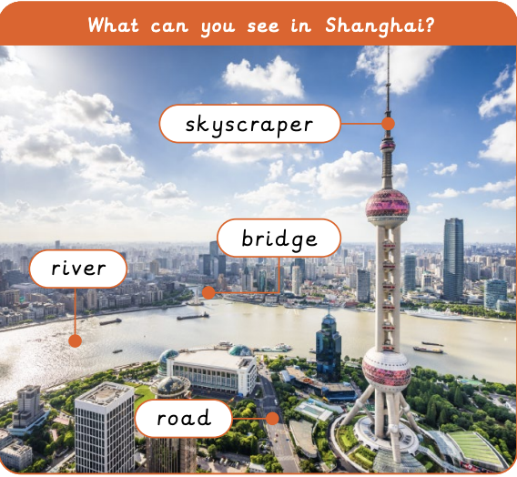

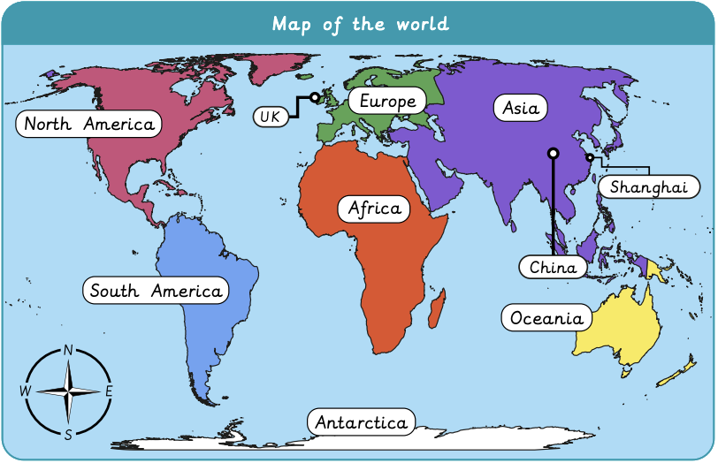
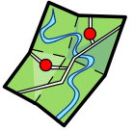

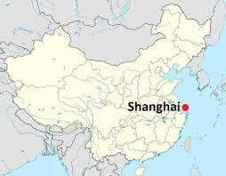
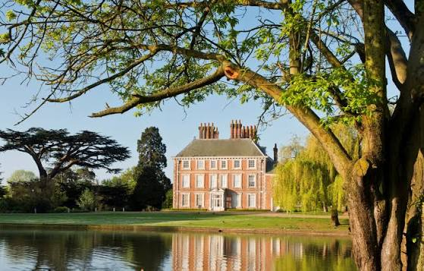
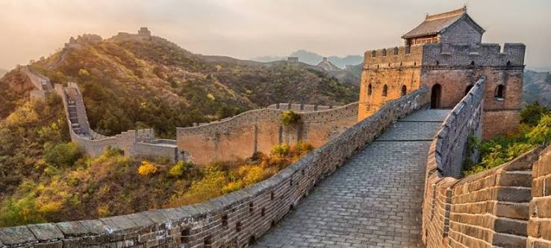
What is it like to live in Shanghai? | Sapphire | Geography | Summer
What I should already know:
We live on Earth and it has land and water
Different places on Earth look different and have different animals and plants
What I will learn:
LO 1: What can we see in our local area?
LO 2: Can we map our local area?
LO 3: Where in the world is China?
LO 4: What can you see in China?
LO 5: What is Shanghai like?
LO 6: How is Shanghai different from our local area?
Key Vocabulary:
continent |  | A very large area of land. Earth has 7 continents
country |  | A place with its own land, people and rules
human feature |  | Something made by people, like buildings, roads or bridges
map |  | A picture that shows were places are
physical feature |  | Something natural, like rivers, mountains or seas

