Slide 1
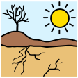
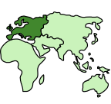
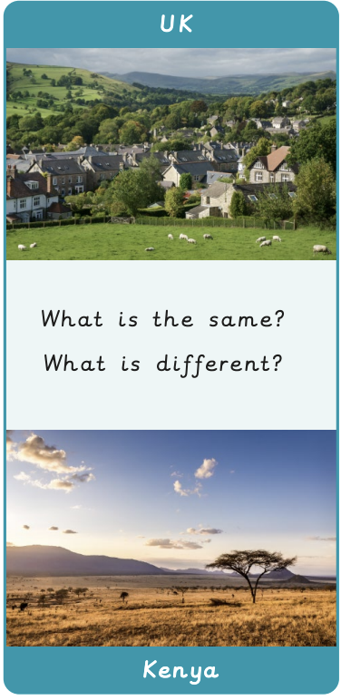
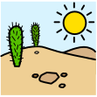
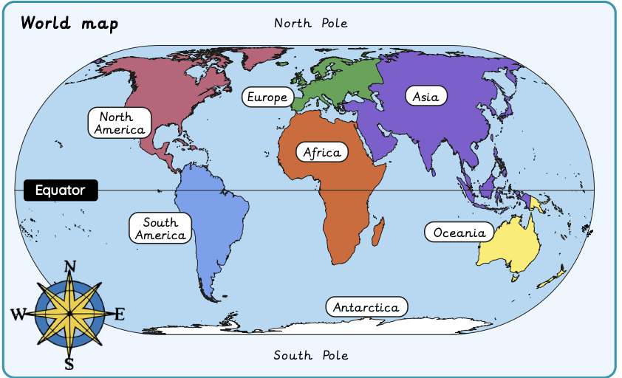
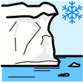

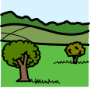
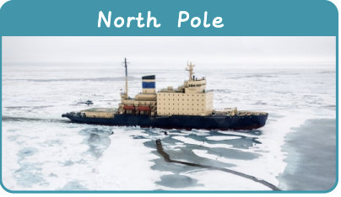
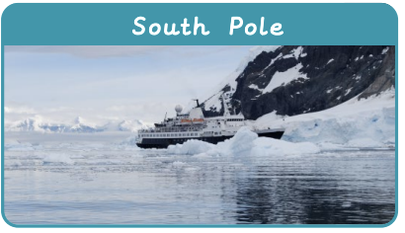

Would you prefer to live in a hot or cold place? | Sapphire | Geography | Spring
What I should already know:
We live on Earth and it has land and water
Different places on Earth look different and have different animals and plants
What I will learn:
LO 1: Where are the continents?
LO 2: Where are the coldest places on Earth?
LO 3: Where is the Equator?
LO 4: What is life like in a hot place?
LO 5: Do we live in a hot or cold place?
LO 6: Would you prefer to live in a hot or cold place?
Key Vocabulary:
arid |  | A place that is very dry with little or no rain
continent |  | A very large area of land. Earth has 7 continents
desert |  | A place that is hot and dry
ice sheet |  | A huge area of thick ice that covers land
polar |  | Places near the North or South pole, which are very cold
rural |  | The countryside, with fields, farms and small villages
temperature |  | Tells us how hot or cold something is

