Slide 1
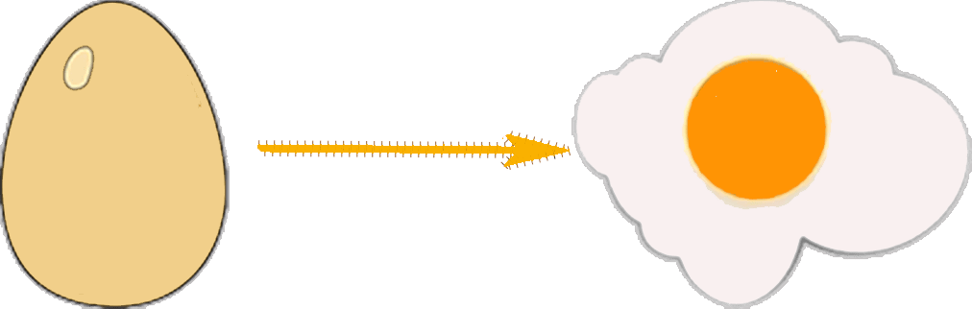
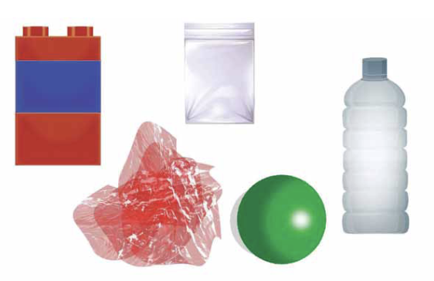
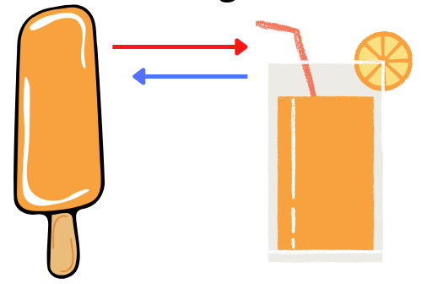








Properties and changes of materials | Emerald | Science | Autumn 1
What I should already know:
Examples of everyday materials and their properties and uses.
How to group materials based on their properties, states of matter.
The effects of heating and cooling.
What I will learn:
LO 1: What do we use materials for?
LO 2: What are thermal conductors and insulators?
LO 3: What happens when we mix materials?
LO 4: What are reversible changes?
LO 5: How do we separate mixtures?
LO 6: What are irreversible changes?
Key Vocabulary:
conductor | Materials that let things pass through them, typically electricity or heat.
dissolve | When a solid mixes with a liquid.
durability | The ability of a material to withstand damage or wear.
insulator | Materials that do not easily let things pass through them.
irreversible | A permanent change that cannot be undone.
mixture | Two or more substances that can be separated.
soluble | When something can dissolve.
solute | The material that is dissolved e.g. salt
solution | The mixture of solid and liquid (solid is not always visible).
solvent | Usually liquid, that dissolves the solid.
Scientists/Inventors:
Stephanie Kwolek (1923 – 2014) - an American chemist who is known for the invention of Kevlar.

