Slide 1
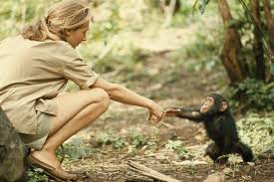
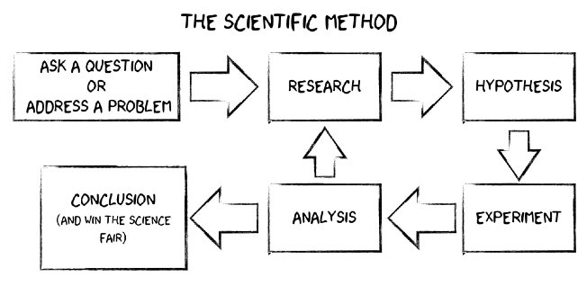








The Scientific Method | Emerald | Science | Summer 2
What I should already know:
How to compare different things such as animals, plants or materials
Classifications of animals and plants
Understand theories need evidence to support or refute them
What I will learn:
LO 1: What is the scientific method?
LO 2: What are variables?
LO 3: What is the best equipment for the job?
LO 4: Is the data reliable?
LO 5: How did the scientific method transform blood transfusions?
LO 6: How did the scientific method help us learn about chimpanzees?
Key Vocabulary:
average | an average is a single number or value that best represents a set of data
conclusion | a simple summary of what has been found out.
data | a collection of information gathered by observations, measurements, research or analysis
hypothesis | an educated guess as to what will happen during your experiment
precision | how close measurements of the same item are to each other
repeatable | measurements which are very similar when repeated by the same person or group, using the same equipment and method
Scientists/Inventors:
Dr Charles Richard Drew (1904 – 1950) An American surgeon who transformed the field of blood transfusions and developed large-scale blood banks early in World War II.
Dr Jane Goodall (1934 – present) A British primatologist who carried out long-term research on the chimpanzees of Gombe Stream National Park in Tanzania.

