Slide 1
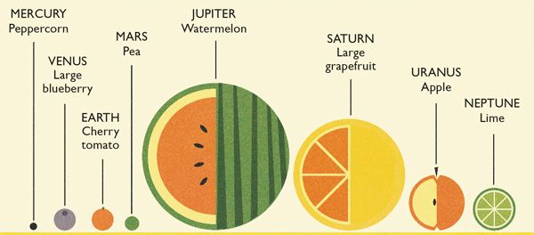
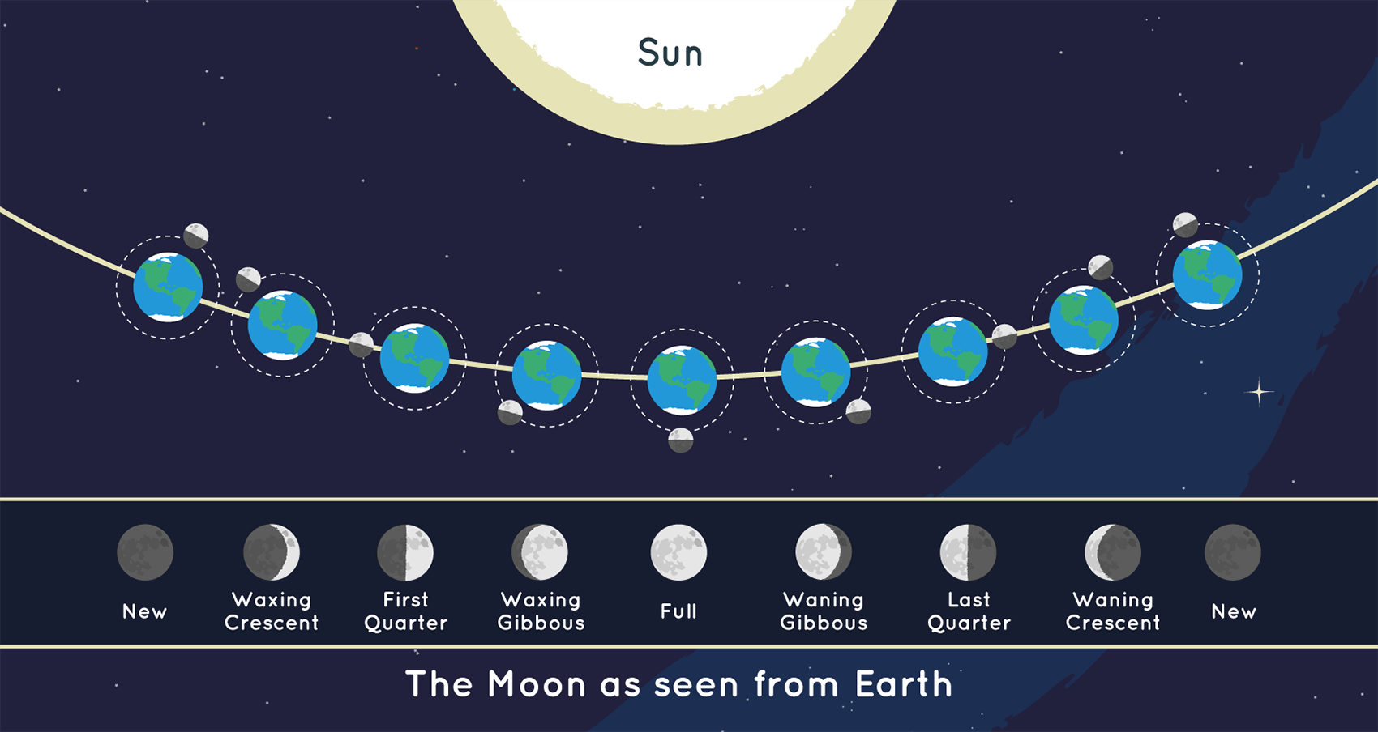








Earth and Space | Emerald | Science | Summer 1
What I should already know:
The names of some planets in our solar system, including Earth is the name of our planet
Light from the Sun is dangerous, and eyes should be protected
Light is needed to see objects and dark is the presence of light
How simple magnets work
What I will learn:
LO 1: Do objects move in space?
LO 2: Why do we have day and night?
LO 3: Does the Moon change shape?
LO 4: Can we use celestial objects to tell the time?
LO 5: What is the Geocentric Model of the solar system?
LO 6: What is the Heliocentric Model of the solar system?
Key Vocabulary:
axis | an invisible line around which an object rotates, or spins.
celestial bodies | a naturally occurring structure outside of the Earth's atmosphere
comet | large objects made of dust and ice that orbit the Sun
galaxy | a group of stars, clouds of gas, and dust particles that move together through the universe
orbit | the path of a planet or moon around another celestial object
phase | A step or stage in something that changes over time.
Scientists/Inventors:
Edwin Hubble (1889 – 1953) An American scientist who identified other galaxies than the Milky Way. A space telescope was named in his honour.
Johannes Kelper (1571 – 1630) A German scientist who developed the theory that planets closer to the Sun have faster orbits than those further away.

