Slide 1
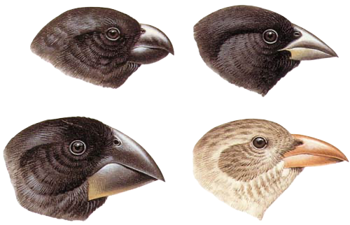
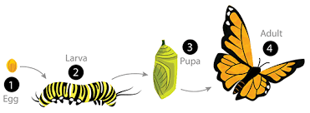








Living things and their habitats | Emerald | Science | Spring 2
What I should already know:
That flowers play a part in the life cycle including pollination and seed formation.
Recognise that living things can be grouped in a variety of ways.
That environments can change which can pose a danger to living things.
How to construct and interpret food chains, identifying producers, predators and prey.
What I will learn:
LO 1: Do all animals develop in the same way?
LO 2: What is metamorphosis?
LO 3: What is inside a cocoon?
LO 4: What came first the chicken or the egg?
LO 5: Why is there variation amongst living things?
LO 6: Do you always need two parents to reproduce?
Key Vocabulary:
asexual | To reproduce without a mate.
camouflaged | When an animal or object is hidden because it blends in with its surroundings.
clone | A copy of a cell or of an entire living thing.
cocoon | A covering or case made by some animals to protect themselves or their young as they develop into adults.
fertilisation | When an egg and pollen (or sperm) join.
metamorphosis | A dramatic change in the life cycle of an animal in which it ends up looking totally different.
offspring | The child or young of a particular human, animal, or plant.
regenerate | The process by which plants and animals replace lost or damaged parts by regrowing them.
variation | The differences between individuals of the same species.
Scientists/Inventors:
David Attenborough (1926 – present) A British natural historian and broadcaster and avid climate change campaigner.

