Slide 1
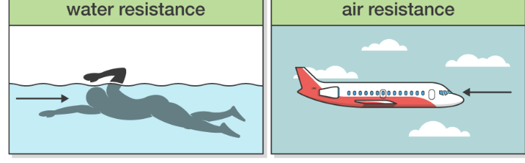
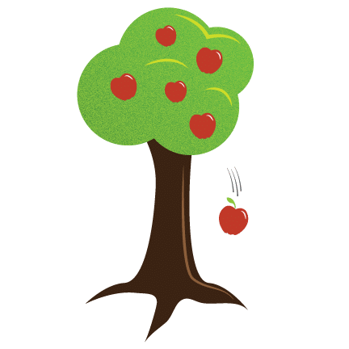
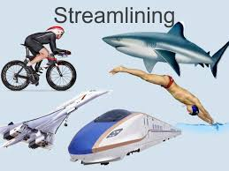








Forces | Emerald | Science | Spring 1
What I should already know:
That some forces need contact between two objects.
Magnets attract or repel each other and attract some materials and not others.
How to group a variety of materials based on whether they are attracted to a magnet.
Magnets have two poles and predict whether two magnets will attract or repel each other.
What I will learn:
LO 1: What happens when friction is low?
LO 2: What happens when friction is high?
LO 3: What is air resistance?
LO 4: What is water resistance?
LO 5: What does gravity do?
LO 6: What are some simple machines?
Key Vocabulary:
aerodynamics | The study of how air moves around a solid object
drag | A force caused by air
fulcrum | Where the arm pivots (a turning point)
lever | A long component that allows an object called a load to be lifted with ease
load | Object you are lifting
mass | A measure of how much matter (or ‘stuff’) is inside an object.
mechanisms | A device used to help turn input forces into larger effects
Newton meter | An instrument for measuring forces
streamlined | When an object is shaped to minimise the effects of air or water resistance.
Scientists/Inventors:
Sir Isaac Newton (1642-1727) A British scientist who made discoveries around gravity.
Gallio Galilei (1564-1642) The founder of modern science. He was interested in studying the effects of forces on movement. Invented the Law of Pendulum which helps to keep track of time.

