Slide 1
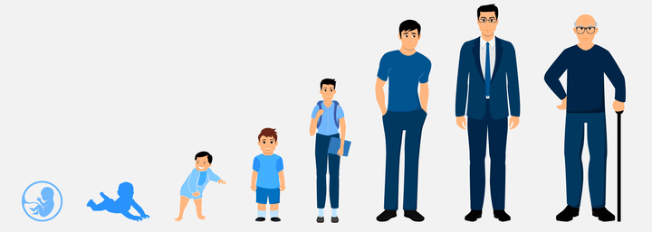
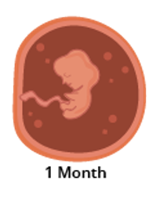
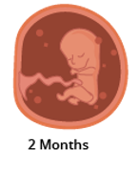
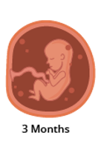
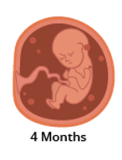
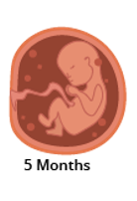
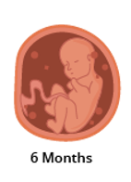
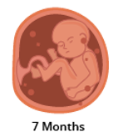
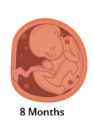
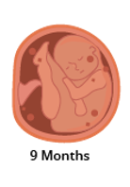








Animals including Humans | Emerald | Science | Autumn 2
What I should already know:
The differences between things that are living or dead.
That animals including humans have offspring that grow into adults.
Living things that can be grouped in several ways.
What I will learn:
LO 1: Where does human life begin?
LO 2: How does a child prepare for adulthood?
LO 3: What is a period?
LO 4: When are new humans made?
LO 5: Do other animals have the same life cycle?
LO 6: What is the last stage of the human life cycle?
Key Vocabulary:
adolescence | The time between being a child and a full adult.
Alzheimer’s | A condition that permanently affects the brain.
dementia | The loss of brain function such as memory, language and problem-solving.
foetus | The unborn offspring that develops from a mammal embryo
gestation period | The period of time when an animal carries its offspring before giving birth.
puberty | Process of physical changes through which a child's body matures into an adult body.
womb | An organ in a woman where a baby grows and develops before it is born.
Scientists/Inventors:
Maria Montessori Italian physician whose careful observations of children shaped our understanding of developmental stages.
Andreas Vesalius Published the first detailed anatomical atlas of the human body (1543).

