Slide 1
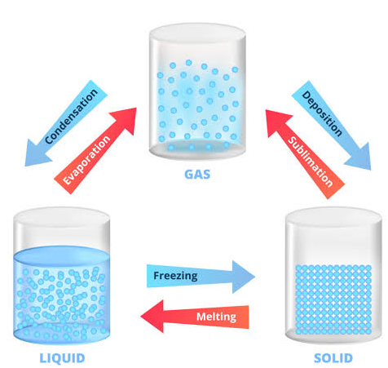
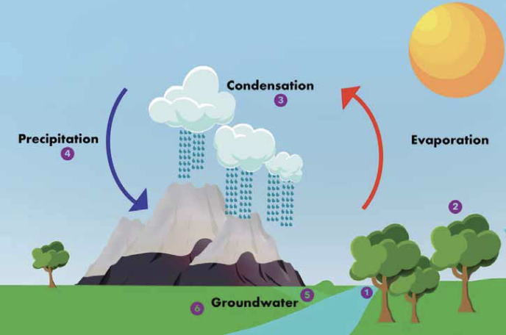
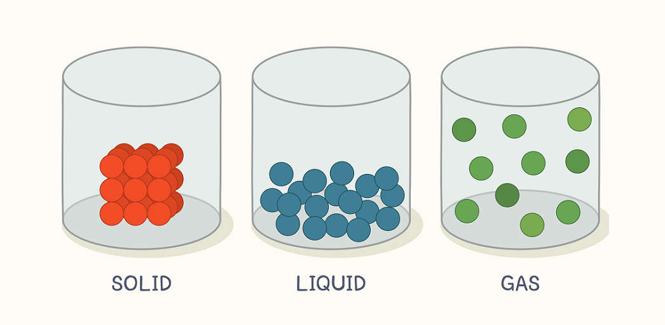








States of Matter | Diamond | Science | Autumn 1
What I should already know:
That different materials do different jobs.
That materials have different uses.
That materials can change shape, by squashing, rolling, bending, stretching or twisting.
What I will learn:
LO 1: What are the states of matter?
LO 2: Can we turn a solid into a liquid?
LO 3: What is the opposite of melting?
LO 4: Why do puddles disappear?
LO 5: Can we make rain?
LO 6: Do we drink the same water dinosaurs did?
Key Vocabulary:
matter | What everything is made from.
states | The different types of matter.
gas | A substance that does not have a fixed shape due to large space between particles.
liquid | A substance that can flow due to small gaps between particles.
solid | A substance that is firm and stable due to tightly packed particles.
melting | A change of state from a solid to a liquid.
freezing | A change of state from liquid to solid.
evaporation | A change of state from a liquid to a gas.
condensation | A change of state from a gas to a liquid.
precipitation | Liquid and solid particles fall from clouds to the ground. E.g. rain or snow.
Scientists/Inventors:
Thomas Edison/ William Coolidge - Incandescent lightbulb and tungsten filament
Anders Celsius – Celsius measurement of temperature

