Slide 1
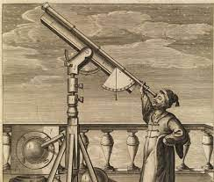
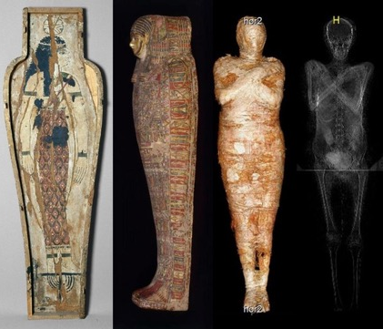
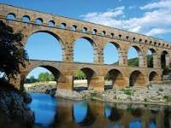








The History of Science | Diamond | Science | Summer 2
What I should already know:
Names of plants and animals and identify seasonal changes within habitats
Name and identify parts of the body
To name and describe basic processes such as how seeds grow and the uses of a range of materials
What I will learn:
LO 1: Did science exist in prehistoric times?
LO 2: How did Ancient Egyptians use science?
LO 3: What was Ancient Greek science?
LO 4: How did Ancient Romans use science?
LO 5: What was science in the Middle Ages?
LO 6: What is modern science?
Key Vocabulary:
aqueducts | A large system for. Carrying water from one place to another
civilisations | A group of people with their own languages and way of life
gravity | A force that pulls things down towards the earth.
hygiene | Keeping yourself clean to stay healthy and stop germs spreading.
machines | Objects that help us do work more easily, often using forces.
prehistoric | The span of time before recorded history or the invention of writing systems
philosophy | The study of the basic ideas about knowledge, truth, right and wrong, religion, nature and meaning of life
technology | The use of knowledge to invent new devices or tools.
Scientists/Inventors:
Aristotle Greek philosopher and scientist.
Ibn al Haytham The pioneer optics and the early scientific method.
Nicolaus Copernicus, Galileo Galilei, Sir Isaac Newton Astronomers and scientists, all developed theories about the planets and the Sun and also gravity

