Slide 1
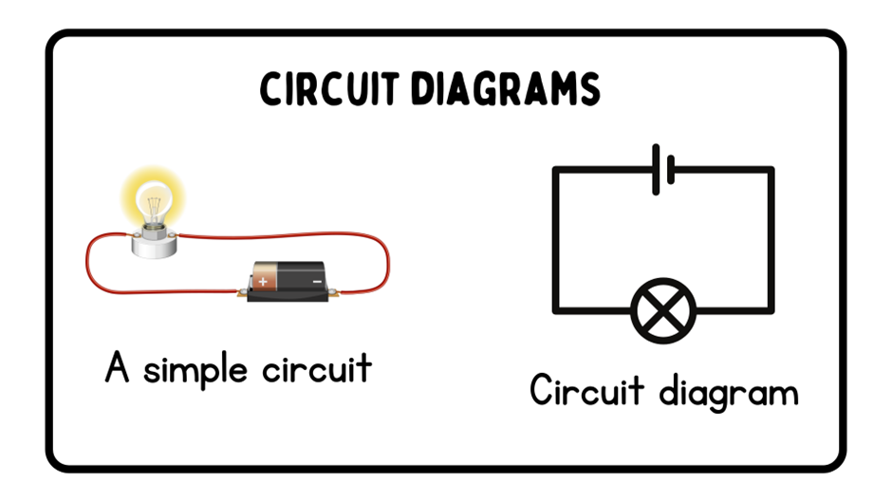
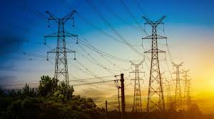








Electricity | Diamond | Science | Summer 1
What I should already know:
The uses for everyday materials.
That a switch is used to turn something on or off.
There are many different battery-operated devices.
What I will learn:
LO 1: What is electricity?
LO 2: How do we produce electricity for our homes?
LO 3: What are the parts of a circuit?
LO 4: What are conductors and insulators?
LO 5: Is electricity safe?
LO 6: How has electricity changed the world?
Key Vocabulary:
charge | The electric energy stored in something.
circuit | A complete path that electricity can travel through.
conductor | material that allows electricity to pass through.
current | A flow of electricity through a wire or circuit.
electrostatic forces | Pushes or pulls caused by electric charges.
fossil fuels | non-renewable resources that formed when prehistoric plants and animals died (oil, coal and gas)
insulator | material that does not allow electricity to pass through it.
nuclear | Energy made by splitting tiny particles inside atoms.
renewable | a natural source of energy that will never run out
static | a build-up of electrical charge on an object
voltage | a measure of how strong the current is in a circuit
Scientists/Inventors:
Benjamin Franklin (1706 -1790) An American founding father, who suggested the use of lightning rods to redirect electricity away from buildings to keep them from burning down.
Luigi Galvani (1737 - 1798) An Italian physician who paved the way for the invention of the battery.
Thomas Edison (1847 – 1931) An American inventor who invented the lightbulb.
Nikola Tesla (1856 – 1943) A Serbian-American electrical engineer who changed the electrical system to transmit electricity over greater distances.

