Slide 1
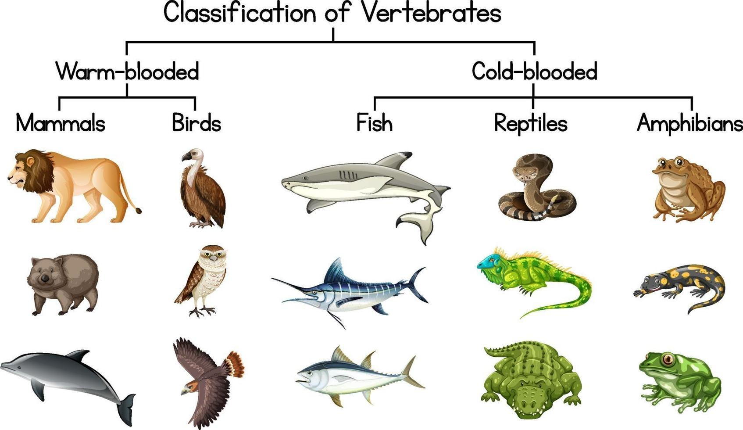
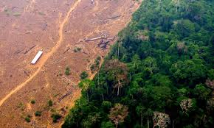








Living things and their habitats | Diamond | Science | Spring 2
What I should already know:
How to make comparisons between things that are living and dead.
Most living things live in habitats to which they are suited.
The basic needs of different animals and plants.
How simple food chains work and use this to explain how animals obtain their food from plants and other animals.
What I will learn:
LO 1: How can we sort living things?
LO 2: What are vertebrates?
LO 3: What are invertebrates?
LO 4: What is a classification key?
LO 5: How can we see things in their habitats?
LO 6: How do humans affect plant and animal habitats?
Key Vocabulary:
cold-blooded | An animal that becomes hotter and colder, depending on the the temperature outside.
deforestation | The clearing or cutting down of forests
endangered | An animal or plant that is at risk of being extinct
extinct | No more individuals of a certain species left alive anywhere in the world
entomologist | A scientist who studies insects.
invertebrates | An animal without a backbone
pooter | A small tool used to safely collect insects by sucking them into a pot.
slash-and-burn | A method of clearing land by cutting plants and burning them.
vertebrates | An animal with a backbone
warm-blooded | An animal that can make their own body heat even when it is cold outside.
Scientists/Inventors:
Carl Linnaeus 1707- 1778 A Swedish biologist famous for developing a system to name animals.
Aristotle 384 - 322 BC Ancient Greek philosopher who classified living things as either plants or animals.

