Slide 1
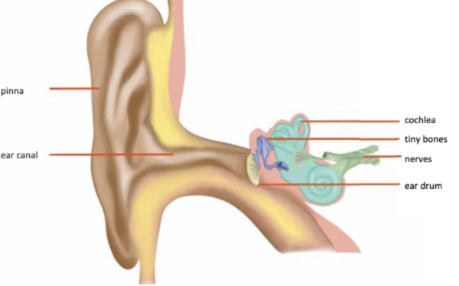
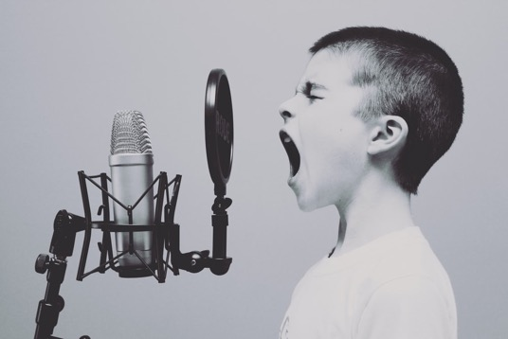
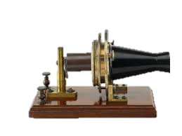
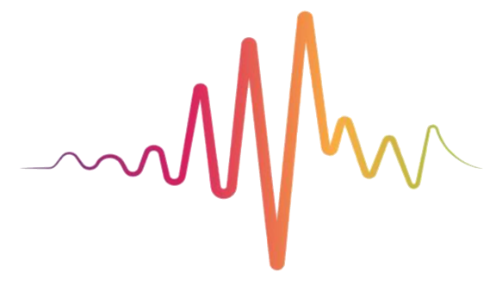








Sound | Diamond | Science | Spring 1
What I should already know:
The suitability of everyday materials; shapes can be changed by squashing, bending or twisting.
What part of the body is associated with each sense.
Different states of matter have different properties
What I will learn:
LO 1: How are sounds made?
LO 2: How does sound travel?
LO 3: How do our ears work?
LO 4: Big or small?
LO 5: High or low?
LO 6: Can you keep the noise down?
Key Vocabulary:
amplifier | A machine that makes sounds louder.
audible range | The range of sounds that humans can hear.
audiologist | A hearing doctor who helps people with hearing problems.
decibel | The unit used to measure sound and how loud it is.
echo | A sound you hear again because sound waves have have reflected off a surface.
hertz | The unit used to measure how fast something vibrates.
pitch | How high or low a sound is.
sound | A type of energy that you can hear.
sonar | A method of finding objects using sound waves.
ultrasound | Very high frequency sound waves that humans cannot hear.
vibration | A quick movement forwards and backwards that makes a sound.
volume | How loud or quiet a sound is.
Scientists/Inventors:
Alexander Graham Bell (1847-1922) A Scottish-Canadian inventor, scientist and engineer who is credited with inventing the first practical telephone. He also made the first phone call.

