Slide 1
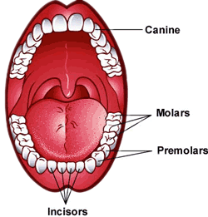
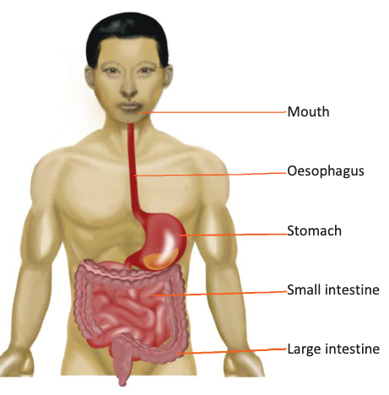
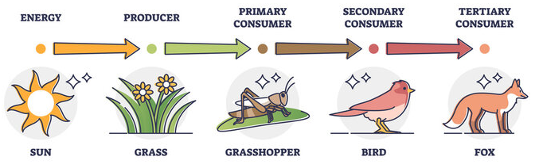








Animals including Humans | Diamond | Science | Autumn 2
What I should already know:
That animals get their food from plants and other animals, from a simple food chain.
That parts of the body work together to perform different functions. E.g. muscles
A balanced diet helps our body.
What I will learn:
LO 1: Can we group animals by what they eat?
LO 2: Who eats what?
LO 3: Why are we born without teeth?
LO 4: Why doesn’t the stomach eat itself?
LO 5: How big is the small intestine?
LO 6: Are all bacteria bad for us?
Key Vocabulary:
absorb | To soak up or take in liquid.
bacteria | Tiny living things that are everywhere; some are helpful, some can make us ill.
carnivore | An animal that eats other animals.
consumer | A consumer is a living thing that eats another living thing for food, to get energy.
digestion | How the body breaks down food so we can use it for energy.
food chain | A diagram showing the transfer of energy from one organism to another.
herbivore | An animal that only eats plants.
nutrients | The useful parts of food that help us grow and stay healthy.
oesophagus | The tube that carries food from your mouth to your stomach.
omnivore | An animal that eats both animals and plants.
predator | An animal that hunts and eats meat.
prey | An animal that is hunted and eaten by a predator.
producer | An organism at the start of the food chain that makes its own food from the Sun.
Scientists/Inventors:
Anton van Leeuwenhoek (1670s) First to observe bacteria using a microscope
William Beaumont (1820s) Early studies of digestion through patient observation.

