Slide 1

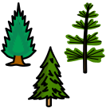
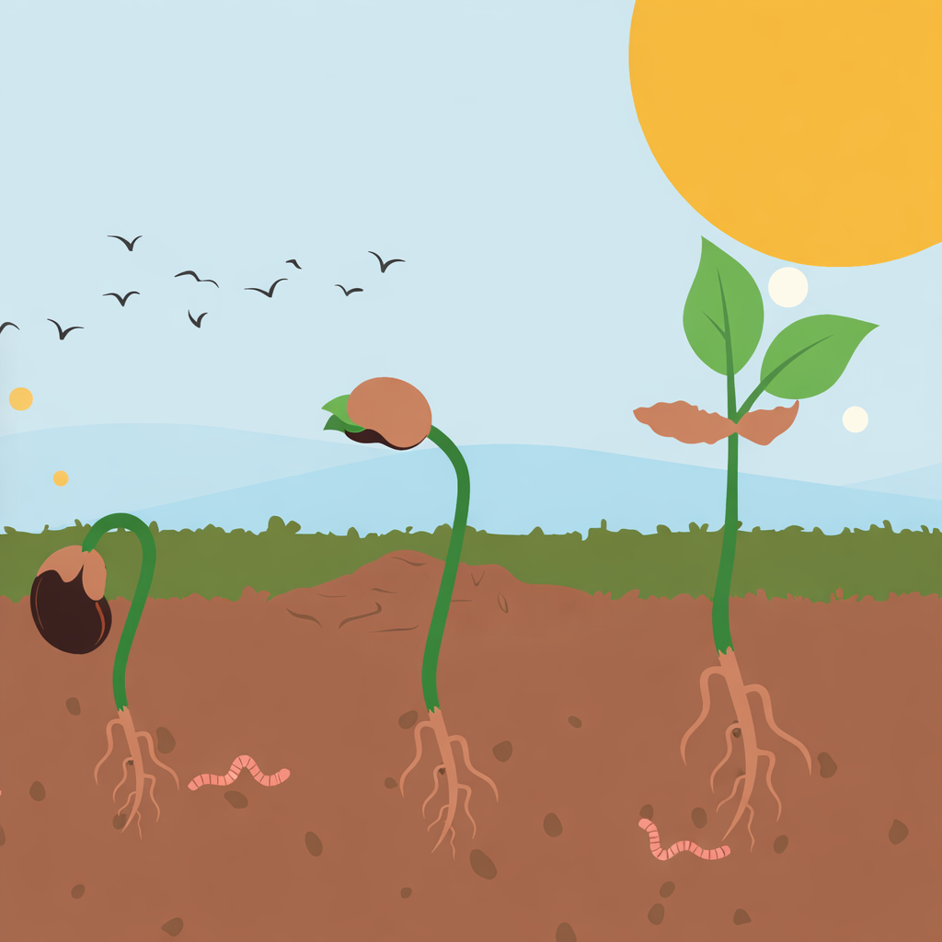
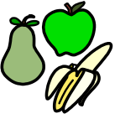
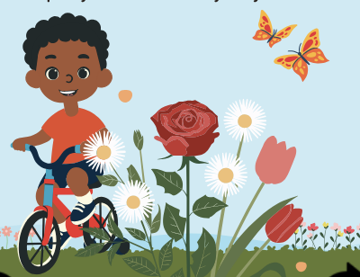
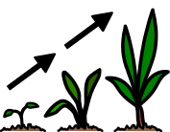

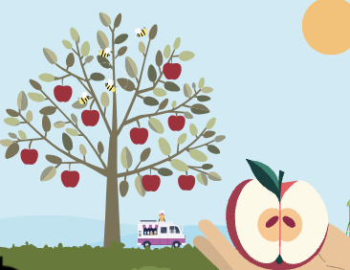
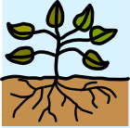





Plants | Sapphire | Science | Autumn 1
What I should already know:
Plants grow and change over time
Plants can be found in different places such as gardens, parks and forests
Explored the natural world
What I will learn:
LO 1: What is that plant?
LO 2: What part is that?
LO 3: Is it evergreen?
LO 4: What is that flower?
LO 5: How do plants grow?
LO 6: Where do fruits come from?
Key Vocabulary:
deciduous |  | Trees that lose their leaves.
evergreen |  | Trees that keep their leaves.
fruit |  | The part of the plant that holds seeds.
grow |  | When a plant gets bigger.
leaves |  | The flat green parts of a plant.
plant |  | A living thing that grows in soil.
trunk |  | The main part of a tree

