Slide 1
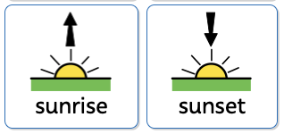
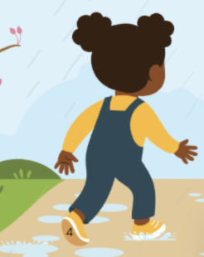
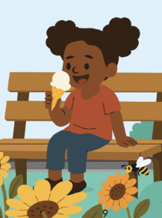
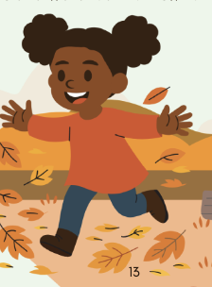
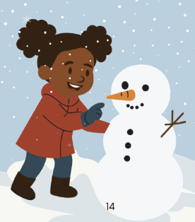




Seasonal Changes | Sapphire | Science | Summer 2
What I should already know:
I have explored the natural world.
I have noticed simple seasonal changes.
I can describe basic weather conditions.
What I will learn:
LO 1: What are the seasons?
LO 2: What happens in spring?
LO 3: What happens in summer?
LO 4: What happens in autumn?
LO 5: What happens in winter?
LO 6: Can we compare the seasons?
Key Vocabulary:
blossom |  | Flowers that grow on trees in spring.
cycle |  | Something that repeats.
hibernation |  | When some animals sleep through winter.
leaves |  | Grow on trees and plants.
migration |  | When animals move to another place.
season |  | One of the four parts of the year.
temperature |  | How hot or cold it is.
spring
summer
autumn
winter

