Slide 1

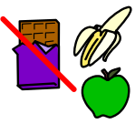
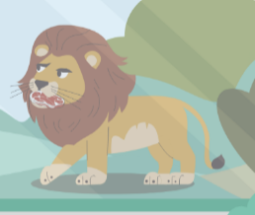

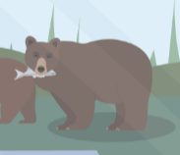

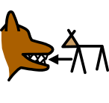

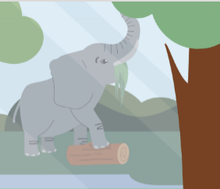
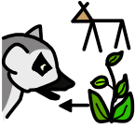





Animal Diets | Sapphire | Science | Summer 1
What I should already know:
I can explore animals through play and stories.
I know how to care for living things.
I can describe simple animal characteristics.
What I will learn:
LO 1: Where does food come from?
LO 2: Who eats plants?
LO 3: Who only eats meat?
LO 4: Who eats both?
LO 5: What are some unusual foods?
LO 6: How do animals eat differently?
Key Vocabulary:
animal |  | A living thing that moves, breathes and eats.
diet |  | The food that an animal eats.
meat |  | Food from animals.
plant |  | Food from trees, leaves, fruit or vegetables.
carnivore |  | An animal that eats meat.
herbivore |  | An animal that eats plants.
omnivore |  | An animal that eats both plants and meat.
origin |  | Where something comes from.

