Slide 1



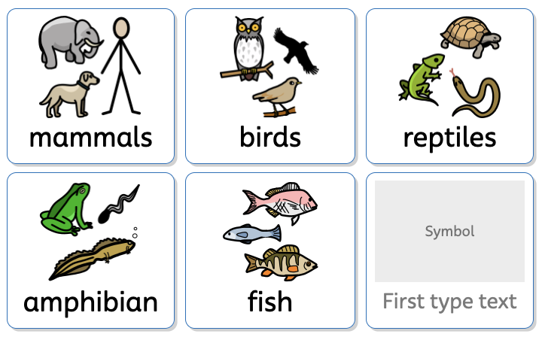









Animal Groups | Sapphire | Science | Spring 2
What I should already know:
I can explore animals through play and stories.
I know how to care for pets and understand basic animal needs.
I can recognise common animals.
What I will learn:
LO 1: Is it a mammal?
LO 2: Can all birds fly?
LO 3: What is a reptile?
LO 4: Water or land?
LO 5: How do fish breathe underwater?
LO 6: What makes animals different?
Key Vocabulary:
habitat |  | Where an animal lives.
fur |  | Hair covering mammals.
feathers |  | Covering for birds
scales |  | Covering reptiles and fish.
gills |  | Help fish breathe underwater.
lungs |  | Helps animals breathe air.
land |  | Habitat for mammals, birds and reptiles.
water |  | Habitat for fish and some amphibians.

