Slide 1




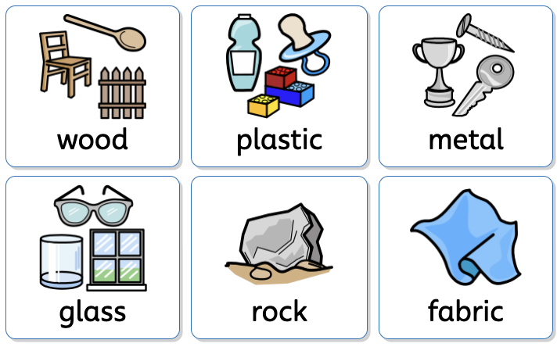



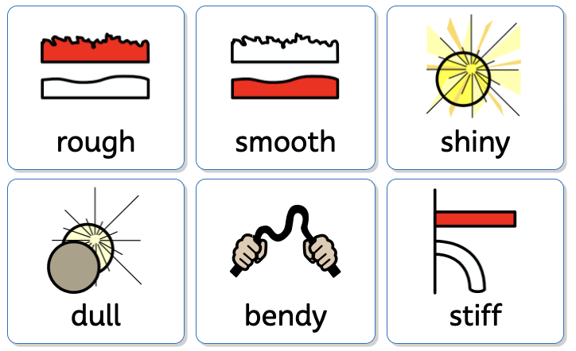

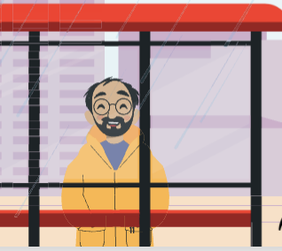





Everyday Materials | Sapphire | Science | Spring 1
What I should already know:
I can explore materials through play.
I can use simple tools safely.
I can describe textures and make simple observations.
What I will learn:
LO 1: What is it made of?
LO 2: Is it hard or soft?
LO 3: Is it rough or smooth?
LO 4: What keeps us dry?
LO 5: What looks shiny?
LO 6: Which material is best?
Key Vocabulary:
object |  | A thing we can see or touch.
material |  | What an object is made from.
hard |  | Not easy to bend or break.
soft |  | Easy to press or squash.
absorbent |  | Soaks up water..
waterproof |  | Keeps water out

