Slide 1



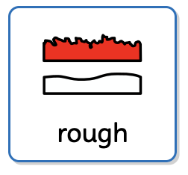


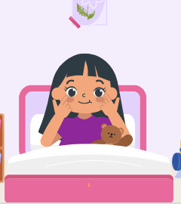










My body and My senses | Sapphire | Science | Autumn 2
What I should already know:
I can say what I see, hear and feel.
I can use tools and materials safely.
I can look after myself.
What I will learn:
LO 1: What can our bodies do?
LO 2: What are the senses (smell)?
LO 3: How do we see?
LO 4: What is that sound?
LO 5: How does it taste?
LO 6: What can we feel?
Key Vocabulary:
smell |  | The sense of scent.
sight |  | The sense of seeing.
hear |  | The sense of sound.
taste |  | The sense of flavour.
touch |  | The sense of feeling.

