Slide 1
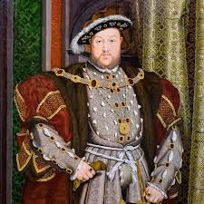
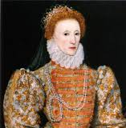
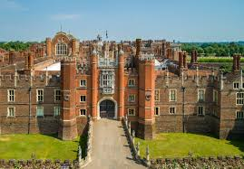
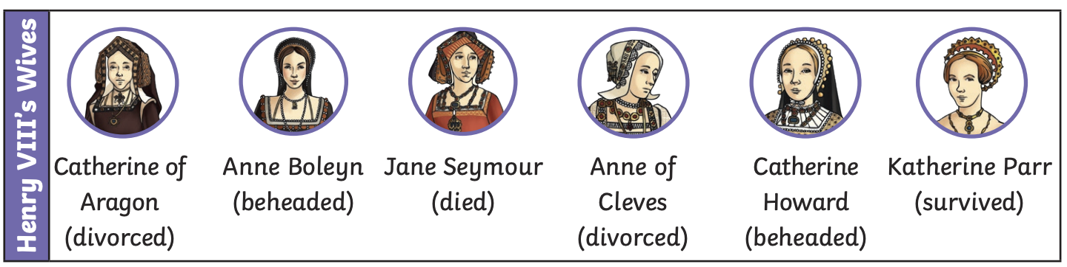
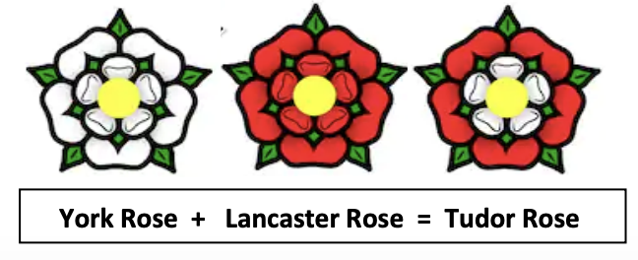
The Tudors | Emerald | History | Spring
What I should already know:
About the life of other significant individuals such as Samuel Pepys, Florence Nightingale.
To understand periods of history from the Stone Age to 1066 in Britain.
What I will learn:
LO 1: Fair ruler or tyrant? What was Henry VIII really like?
LO 2: Why did Henry VIII have so many wives?
LO 3: Why was Anne Boleyn executed?
LO 4: What was a Royal Progress?
LO 5: What was a Royal Progress like?
LO 6: What can inventories tell us about life in Tudor times?
Key Vocabulary:
Catholic | A member of the Catholic Church where the Pope is the head.
divorce | The legal end of a marriage
heir | A person who will inherit the crown after the current King or Queen dies.
monarch | A sovereign head of state (King/ Queen)
Protestant | A member of a Christian church, separate from the Catholic church.
reformation | The move away from the Catholic church to become Protestant.
reign | The time the King or Queen is on the throne
treason | A crime of betraying your country.
tyrant | A person or ruler who uses their authority cruelly.
Significant People:
Henry VIII (1491- 1547) King of England after his father Henry VII from 1509 to 1547. Famous for marrying six times to try and get a son.
Hans Holbein (unknown – 1543) A German painter famous for painting many portraits of Henry VIII.

