Slide 1
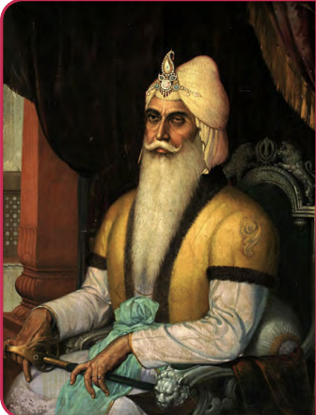
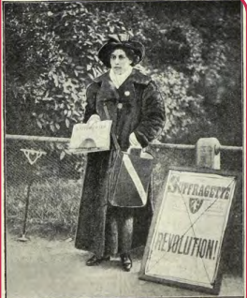
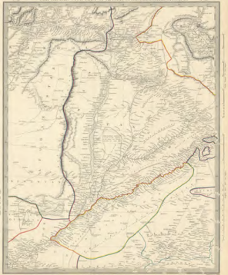

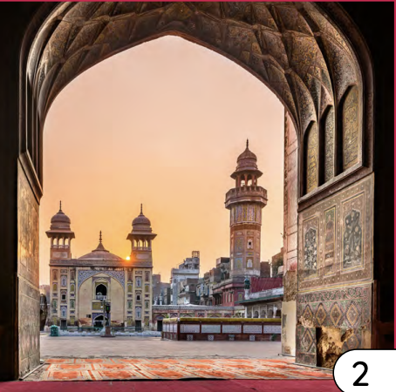
Sikh Empire | Emerald | History | Summer
What I should already know:
Understand that different civilisations have existed in the past
Understand that religion can influence how people live and what they believe
Know that leaders and important figures influence how a place is ruled
What I will learn:
LO 1: How did the Sikh Empire begin?
LO 2: How do Sikh beliefs impact society?
LO 3: What made Lahore important to the Sikh Empire?
LO 4: Why is Ranjit Singh historically significant?
LO 5: How do different interpretations shape our understanding of the Sikh Empire?
LO 6: How do the achievements of Sophia Duleep Singh compare to Ranjit Singh?
Key Vocabulary:
alliance | When two groups or countries agree to help and support each other.
bias | When someone favours one side or idea more than another, even if it isn’t fair.
culture | The beliefs, traditions, food, language and ways of life shared by a group of people.
cultural exchange | When people from different cultures share ideas, traditions, food or skills with people.
legacy | What a person, group or empire leaves behind that still matters today.
perspective | The way someone sees or understands something, based on their experiences.
politics | How a country or place is run, including leaders, laws and decisions.
society | A community of people who live together and follow shared rules and traditions.
suffrage | The right to vote in elections.
tax | Money people pay to the government so it can provide services like schools, roads and hospitals.
trade route | A path or road used to move goods from one place to another for buying and selling.
Significant People:
Maharaja Ranjit Singh (1780-1839) The leader who united the Sikh warriors and created the Sikh Empire.
Princess Sophia Duleep Singh (1876-1948) The daughter of the last Maharaja. A famous suffragette in Britain.

