Slide 1
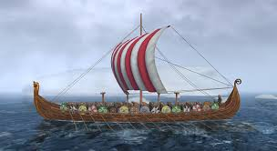
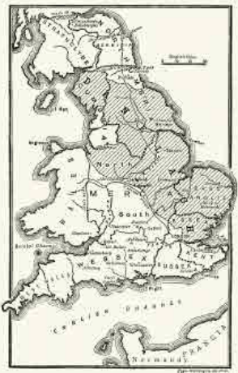

The Vikings | Emerald | History | Autumn
What I should already know:
The Anglo-Saxons came from Scandinavia to invade and settle in Britain in 450AD.
Britain was divided into many kingdoms
Many groups of people co-existed at the same time.
What I will learn:
LO 1: When and why did the Vikings come to Britain?
LO 2: Were the Vikings raiders, traders or something else?
LO 3: Where were the Viking trading routes and why was trade important?
LO 4: Why are there different Viking sagas explaining the same event and what does this tell us about the Vikings?
LO 5: What were the impacts of Viking raids and settlements on local communities in Britain?
LO 6: What were the Vikings’ achievements, and how did they impact the world?
Key Vocabulary:
exchange | Giving something to someone and receiving something in return
invader | Someone who enters a country by force with an army.
Jorvik | The Vikings invaded York and renamed it Jorvik.
oral traditions | The passing of stories and poems by word of mouth from one generation to another.
raider | People who enter a place illegally, and often violently, to steal.
saga | Stories told and retold down the ages by Norse peoples.
settlement | A place or region where people come to live.
trade route | A long-distance route along which commercial goods are transported.
Significant People:
King Canute (995-1035AD) Viking King of Britain, Denmark and Norway.
King Alfred the Great (849-899AD) Defeated the Vikings in many battles to keep Britain under Anglo-Saxon rule.
Guthrum (879-890AD) King of the Vikings in Danelaw at the time of the treaty with the Anglo-Saxons.
William the Conqueror (1028-1087AD) Became King of England in 1066 after winning the Battle of Hastings.

