Slide 1
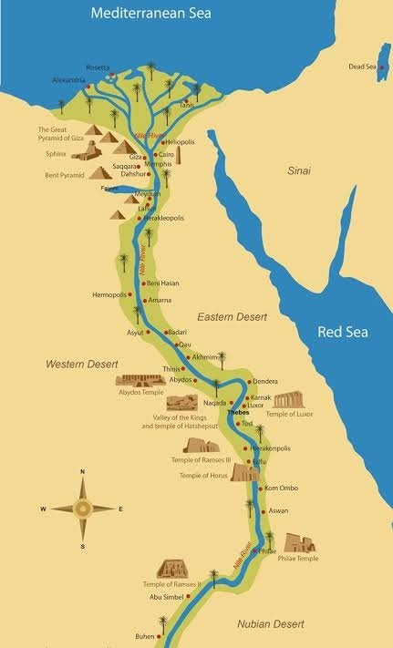
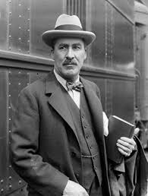
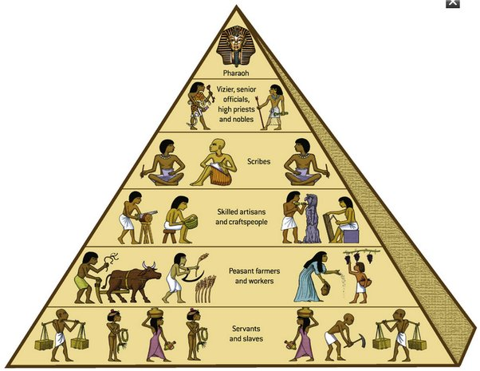
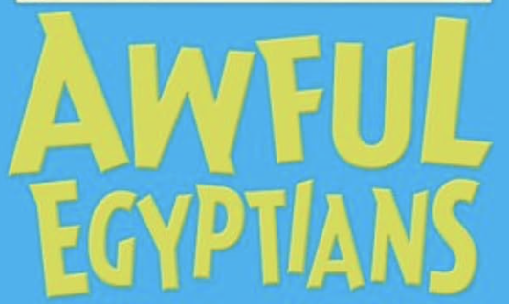
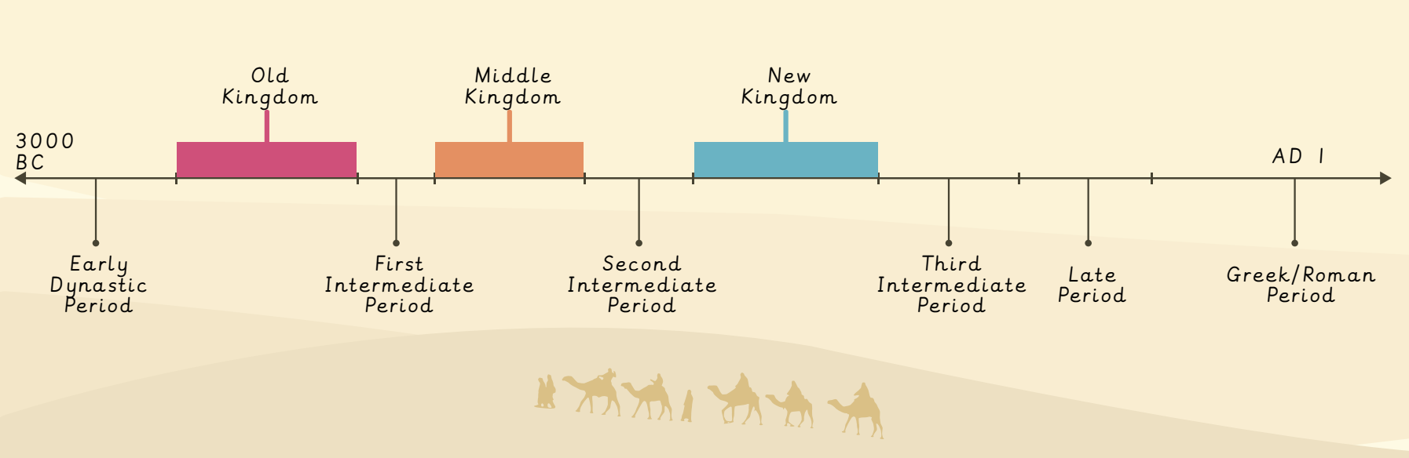
Ancient Egyptians | Diamond | History | Autumn
What I should already know:
Egypt is a country in the continent of Africa.
The climate of Egypt is different to that of the UK.
What life was like in Stone Age Britain.
What I will learn:
LO 1: Where and when did the first civilisations appear?
LO 2: Why was the River Nile important to ancient Egyptians?
LO 3: How do we know so much about ancient Egyptians?
LO 4: What do sources suggest about gods and goddesses?
LO 5: What did people in Ancient Egypt believe happened after death?
LO 6: Who ruled ancient Egypt and what happened to them when they died?
Key Vocabulary:
book of the dead | A series of written spells which guided the dead to the afterlife.
civilisation | A large group of people with a common language, way of life and governance.
hierarchy | A system where a society is ranked according to relative status or authority
hieroglyphics | A type of writing that used a combination of pictures and symbols.
immortal | Able to live forever
mummification | The Egyptian process of preserving a body, so it could travel to the afterlife.
preserve | To prevent a body from decaying.
pyramid | Named after its shape, a large stone tomb built for a pharaoh.
River Nile | The longest river in the world, along which the ancient Egyptian civilisation developed.
sarcophagus | A decorated stone coffin, used in ancient Egypt.
Significant People:
Howard Carter (1874 – 1939) A British born Egyptologist famous for discovering the tomb of Tutankhamun in 1922.

