Slide 1
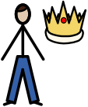
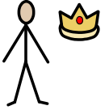
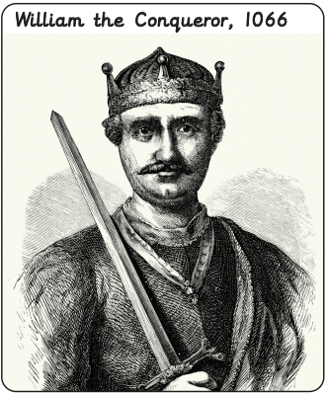
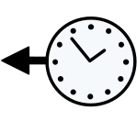

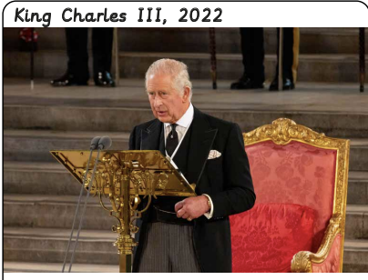

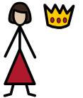
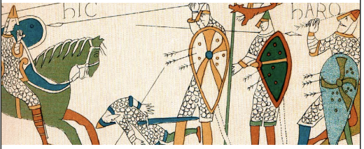
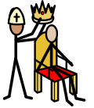
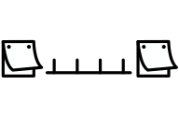
What is a monarch? | Sapphire | History | Summer
What I should already know:
Know some similarities and differences between things in the past and now
Comment on images of familiar situations in the past
What I will learn:
LO 1: What is a monarch?
LO 2: Who is our monarch today?
LO 3: How did William the Conqueror become King of England?
LO 4: How did William the Conqueror rule?
LO 5: How did castles change?
LO 6: What was a monarch in the past?
Key Vocabulary:
king |  | A man who leads a country
monarchy |  | When a country is ruled by a king or queen
past |  | Events that have already happened
power |  | Being able to make important decisions
present |  | What is happening now
queen |  | A woman who leads a country
ruler |  | Someone in charge of a place or people
timeline |  | A line to show the order of important events in the past

