Slide 1


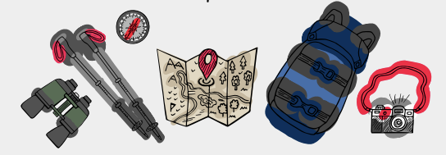


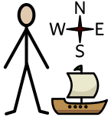
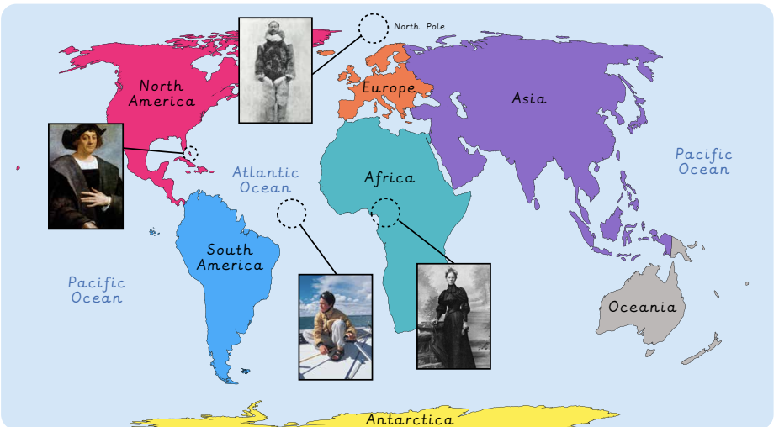



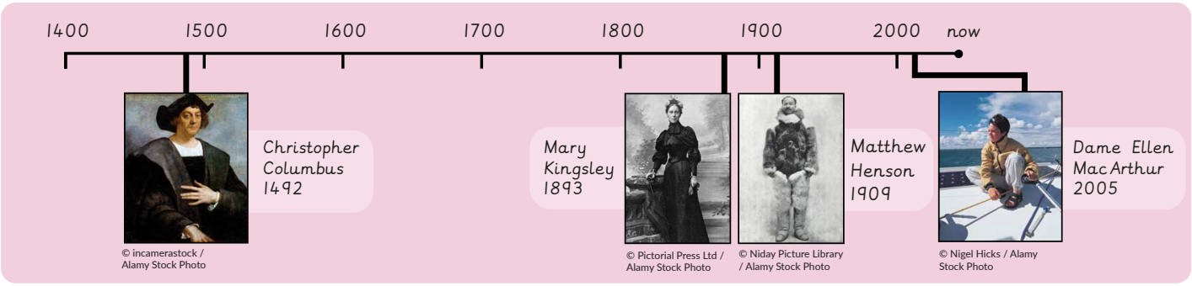
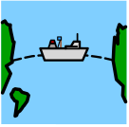
How have explorers changed the world? | Sapphire | History | Spring
What I should already know:
Know some similarities and differences between things in the past and now
Comment on images of familiar situations in the past
What I will learn:
LO 1: What is an explorer?
LO 2: Where have explorers travelled and when?
LO 3: Who was Christopher Columbus and what did he do?
LO 4: Who was Matthew Henson and what did he do?
LO 5: How has exploration changed?
LO 6: How can we remember them?
Key Vocabulary:
discovery |  | Finding something new
explorer |  | Someone who travels to new places
exploration |  | Going to look for new places or information
North Pole |  | The very top of world
past |  | Events that have already happened
present |  | What is happening now
timeline |  | A line to show the order of important events in the past
voyage |  | A long journey, usually by sea

