Slide 1


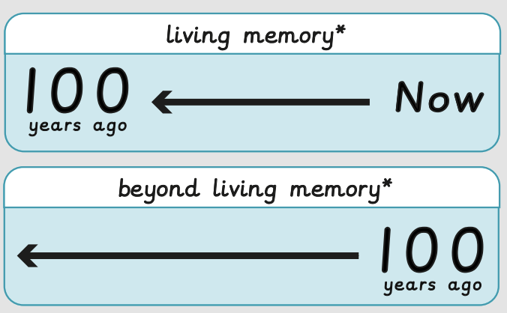



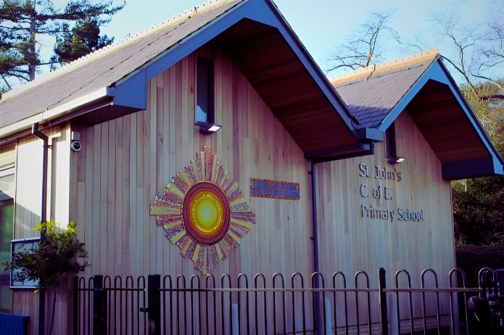
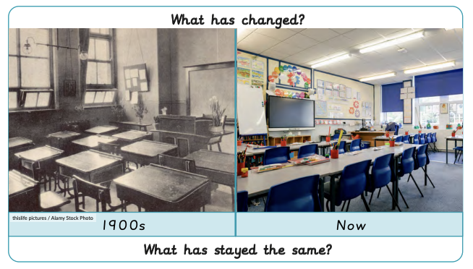

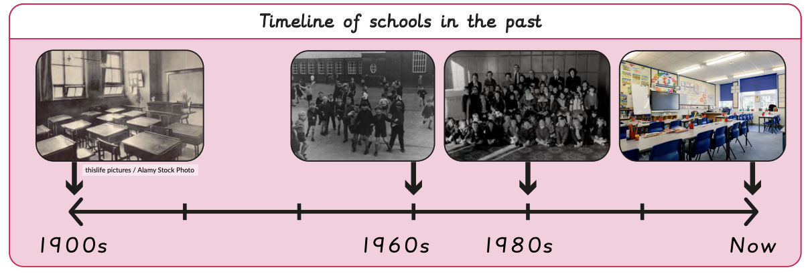
How was school different in the past? | Sapphire | History | Autumn
What I should already know:
Know some similarities and differences between things in the past and now
Comment on images of familiar situations in the past
What I will learn:
LO 1: Were schools different in the past?
LO 2: How have schools changed in living memory?
LO 3: How were schools different in the 1900s?
LO 4: How have schools changed?
LO 5: What is similar and different about schools now and in the past?
LO 6: Would you prefer to have gone to school in the past?
Key Vocabulary:
date |  | A date tells us when something happened
decade |  | A decade is 10 years
future |  | Time still to come
past |  | Events that have already happened
present |  | What is happening now
timeline |  | A line to show the order of important events in the past

