Slide 1
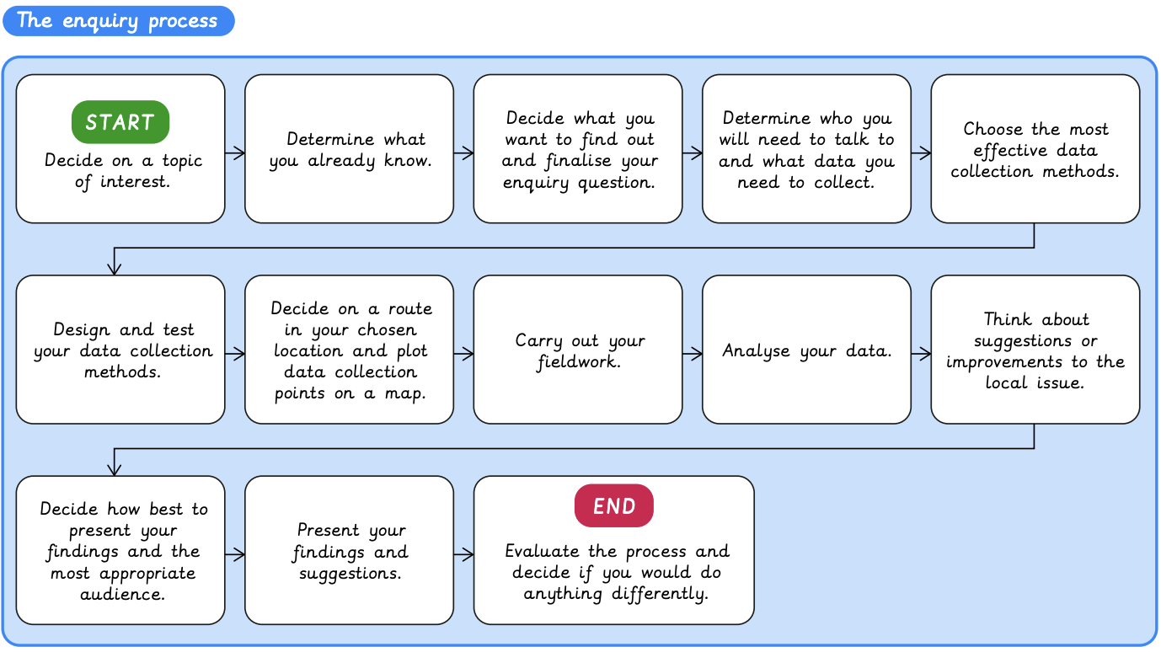
Independent enquiry | Emerald | Geography | Summer
What I should already know:
Understand the features of our local area
Understand human and physical features
Know how to follow directions on a compass
What I will learn:
LO 1: Developing an enquiry question
LO 2: Creating data collection methods
LO 3: Mapping a route
LO 4: Collecting the data
LO 5: Analysing the data
LO 6: Presenting the data
Key Vocabulary:
analyse | To look at something in detail
audience | People who receive a message or watch a performance
data | Numbers or facts collected to prove something
enquiry | An investigation into a question
impact | The influence one thing has on another
improvement | To make something better than it was
present | To show something to other people
process | Steps taken to achieve a particular outcome
risk | A situation where something may be dangerous
route | A way to get from one place to another, marked on a map
viewpoint | A particular way of thinking about something

