Slide 1
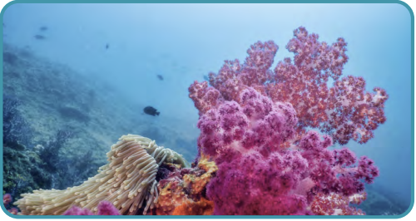
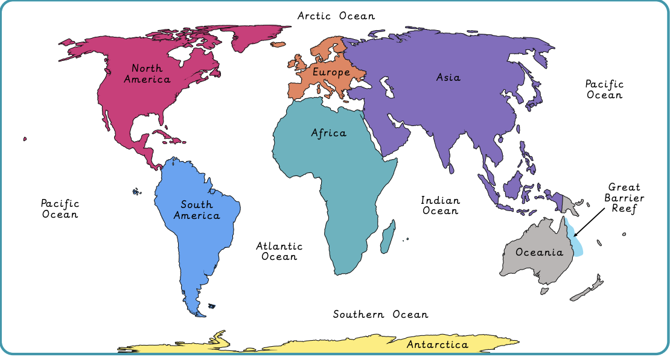
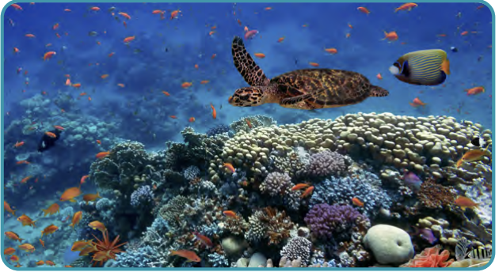
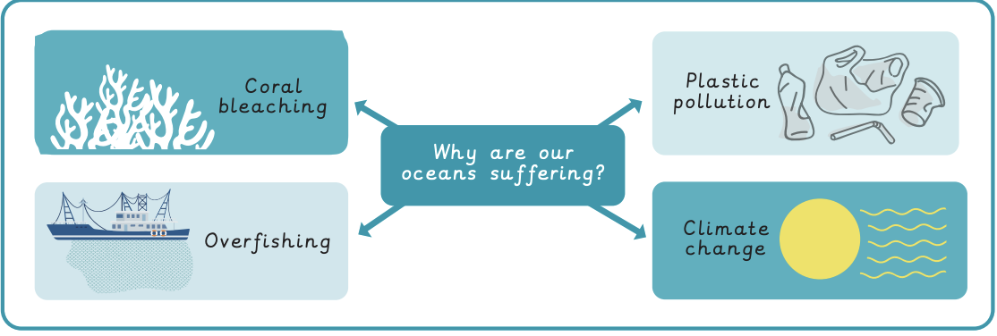
Why do oceans matter? | Emerald | Geography | Spring
What I should already know:
Confidently locate key geographical areas on a map using an atlas
How ecosystems depend on each other
How human actions impact on the environment
What I will learn:
LO 1: How do we use our oceans?
LO 2: What is the Great Barrier Reef?
LO 3: Why are our oceans suffering?
LO 4: What can we do to help our oceans?
LO 5: How littered is our marine environment (data collection)?
LO 6: How littered is our marine environment (findings)?
Key Vocabulary:
acidification | The process of making something acidic
biodegradable | When something naturally breaks down and returns to nature
coral reef | A large rock structure in the ocean formed by corals
coral bleaching | A process which turns coral white, losing its colour
marine | Relating to the ocean
Marine Protected Area | A designated geographical area of the ocean that is protected and managed
microplastics | Tiny pieces of plastic created from plastic waste
ocean current | the movement of a large area of seawater driven by the wind, gravity and water density
overfishing | The number of fish decreases as a result of extreme amounts of fishing
single-use plastic | Plastic only used once and then thrown away
threat | Something likely to cause damage

