Slide 1
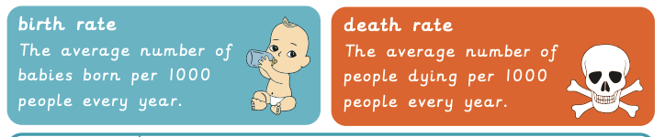
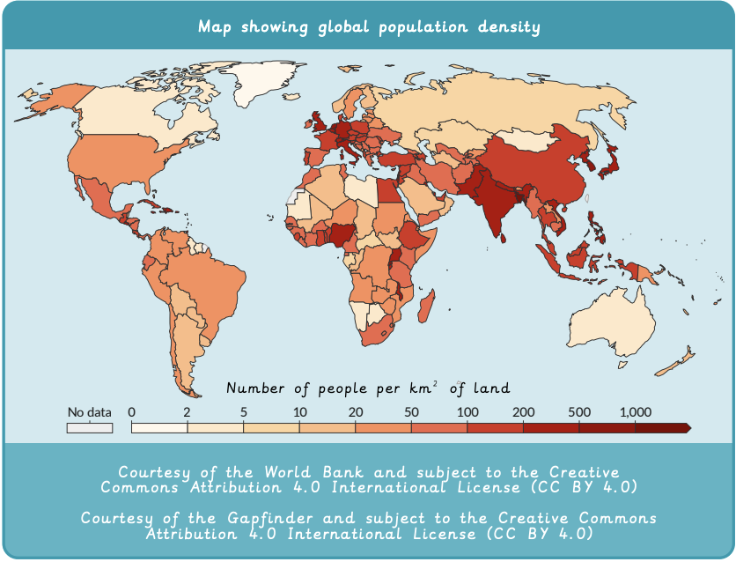
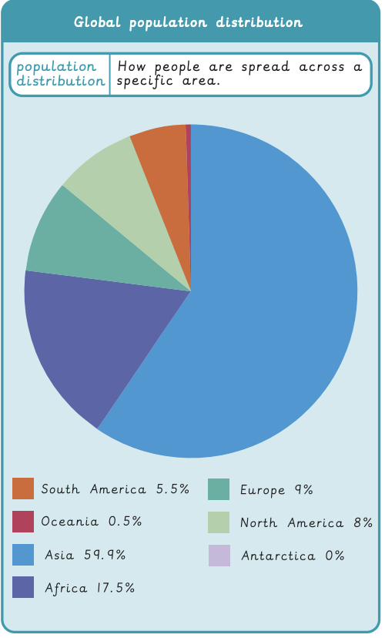
Why does population change? | Emerald | Geography | Autumn
What I should already know:
Understand and describe how places have changed over time
Describe different types of settlements
How to read simple graphs and maps
What I will learn:
LO 1: How is the global population changing?
LO 2: What are birth and death rates?
LO 3: Why do people migrate?
LO 4: How is climate change impacting the population?
LO 5: How is population impacting our environment? (Data collection)
LO 6: How is population impacting our environment? (Findings)
Key Vocabulary:
climate change | When the Earth’s usual weather patterns start to change over time, often becoming hotter, wetter or stormier.
deforestation | Cutting down large areas of forest to make space for farming, buildings or roads.
greenhouse gases | Gases in the air that trap heat and make the Earth warmer.
migration | When people move from one place to another to live.
noise pollution | When loud or constant sounds disturb people, animals or the environment.
pull factors | Good things about a place that attract people to move there.
push factors | Problems that make people want to leave a place.
population density | How many people live in one area. Low density is fewer people that are spread out. High density is lots of people close together.

