Slide 1
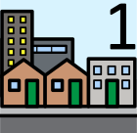
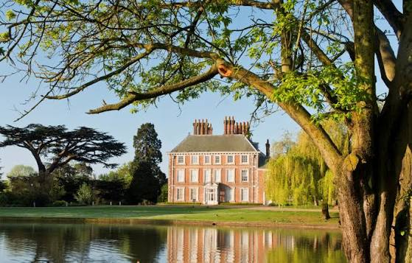
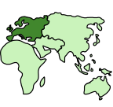


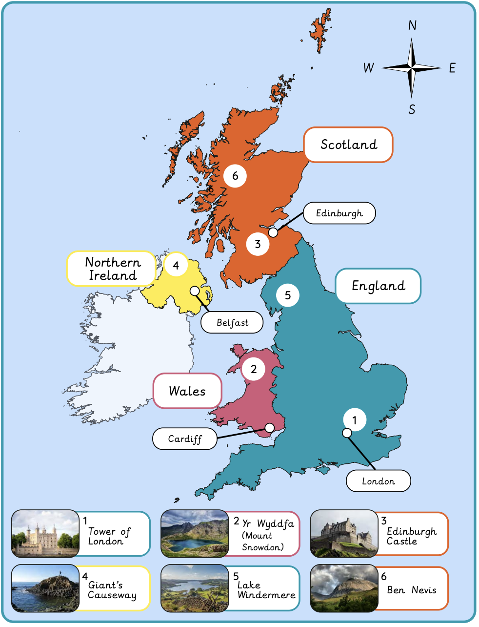
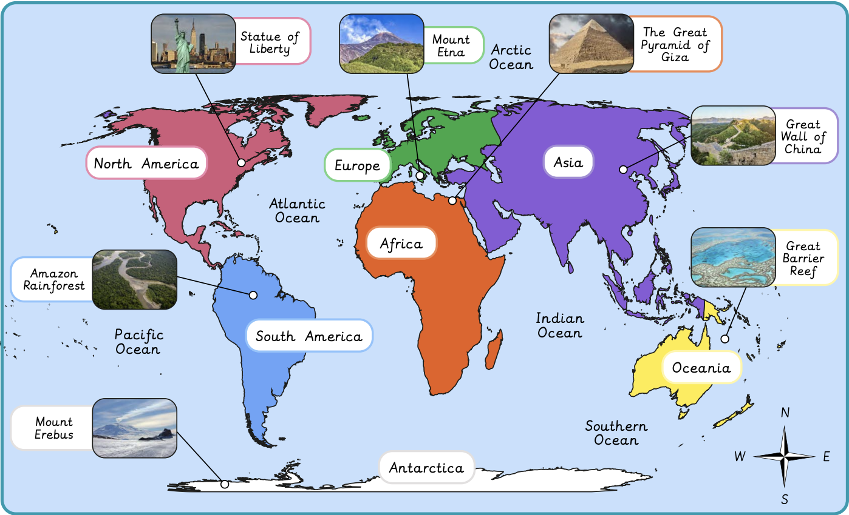
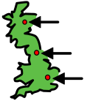

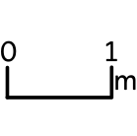
Why is our world wonderful? | Sapphire | Geography | Autumn
What I should already know:
We live on Earth and it has land and water
Different places on Earth look different and have different animals and plants
What I will learn:
LO 1: What are some of the UK’s amazing features and landmarks?
LO 2: Where are some of the world’s most amazing places?
LO 3: Where are our oceans?
LO 4: What is amazing about our local area?
LO 5: Why are natural habitats special?
LO 6: How can we look after natural habitats?
Key Vocabulary:
capital city |  | The most important city in a country where the government works
continent |  | A very large area of land. Earth has 7 continents
country |  | A place with its own land, people and rules
human feature |  | Something made by people, like buildings, roads or bridges
location |  | A place where something is
physical feature |  | Something natural, like rivers, mountains or seas
scale |  | How big or small something is on a map compared to real life

