Slide 1
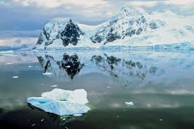
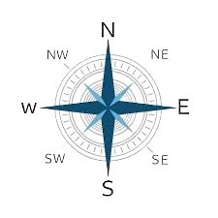
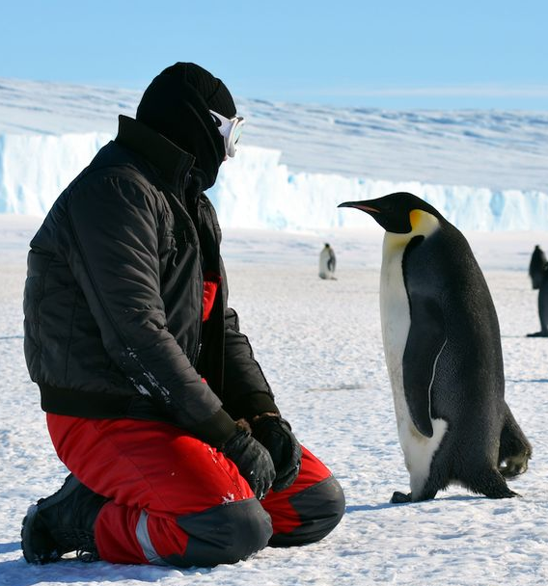
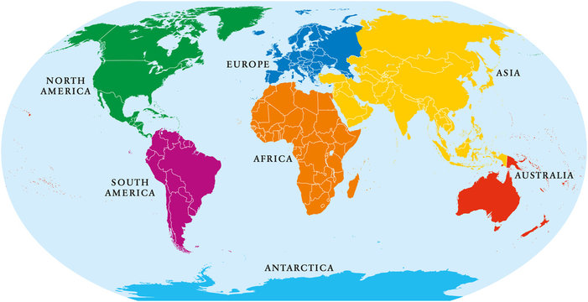
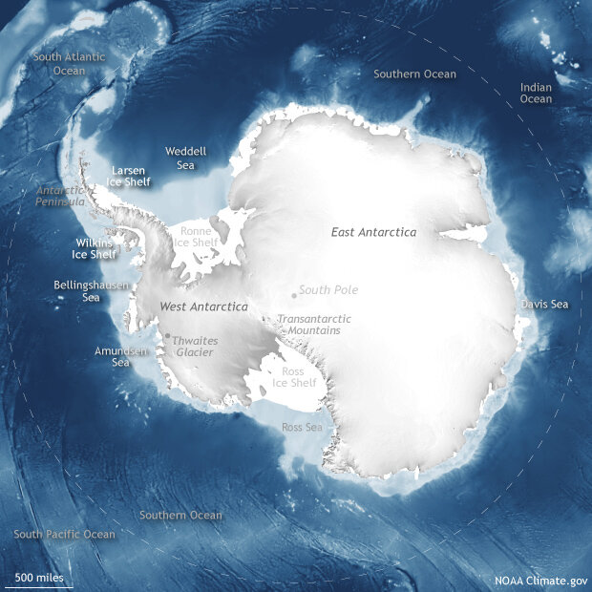
Who lives in Antarctica? | Diamond | Geography | Autumn
What I should already know:
Different types of weather in the UK.
The different seasons we have in the UK.
Directions left, right, up and down to create movement.
What I will learn:
LO 1: What is climate?
LO 2: Where is Antarctica?
LO 3: Who lives in Antarctica?
LO 4: Who was Shackleton?
LO 5: Can we plan an expedition around the school?
LO 6: How did our expedition go?
Key Vocabulary:
climate | The average course or condition of the weather at a place usually over a period of years.
compass points | A mark on a compass that shows the direction.
drifting ice | Detached floating ice in masses that drift with the wind or ocean currents.
hemisphere | A circle drawn around Earth's centre divides it into two equal halves, the northern and southern hemispheres.
ice sheet | A broad, thick sheet of ice covering an extensive area for a long period of time.
iceberg | A huge chunk of ice floating in the ocean.
lines of latitude | Imaginary lines that circle Earth parallel to the Equator from the north pole to the south pole.
lines of longitude | Imaginary lines that run in a north-south direction perpendicular to the equator.
treaty | An agreement that binds two or more countries
Significant People:
Ernest Shackleton (1874 – 1922) An Irish explorer made three expeditions to the continent, most famously in 1914 on the Endurance.
Roald Amundsen (1872 - 1928) A Norwegian explorer known for his polar expedition who were the first to reach the South Pole on December 14th, 1911.

