Slide 1
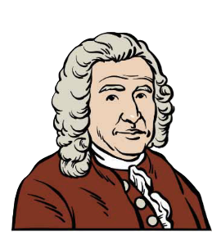
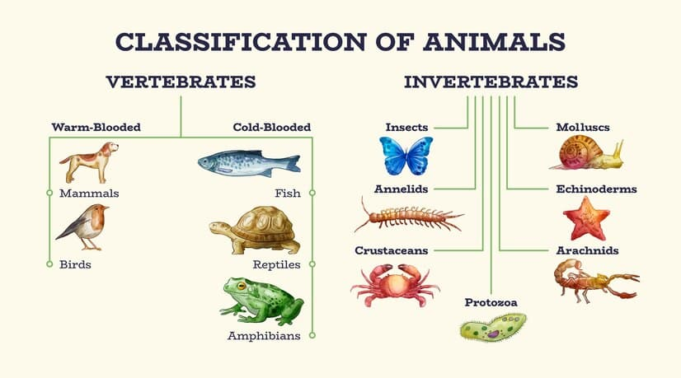








Living things | Emerald | Science | Summer 1
What I should already know:
Living things can be grouped in different ways
There are many different habitats where plants and animals live
Plants and animals depend on their environment to survive
What I will learn:
LO 1: How can we classify living things?
LO 2: What are the main groups of plants?
LO 3: What are microorganisms and where are they found?
LO 4: How does grouping help scientists identify living things?
LO 5: Who was Carl Linnaeus and why was his work important?
LO 6: How can we use classification keys to identify living things?
Key Vocabulary:
classification | grouping living things based on their similarities and differences.
classification key | a set of questions used to identify living things.
ecosystem | a community of living things interacting with their environment.
habitat | the natural home of a plant or animal.
invertebrate | an animal without a backbone.
microorganism | a very small living thing that can only be seen using a microscope.
organism | an individual living thing.
species | a group of living things that can breed together.
taxonomy | the science of naming and classifying living things.
vertebrate | an animal with a backbone.
Scientists/Inventors:
Carl Linnaeus (1707–1778) A Swedish scientist who created a system for naming and classifying living things. This system is still used by scientists today.
Charles Darwin (1809–1882) An English naturalist whose work on evolution helped scientists understand how living things change over time and why classification is important.

