Slide 1
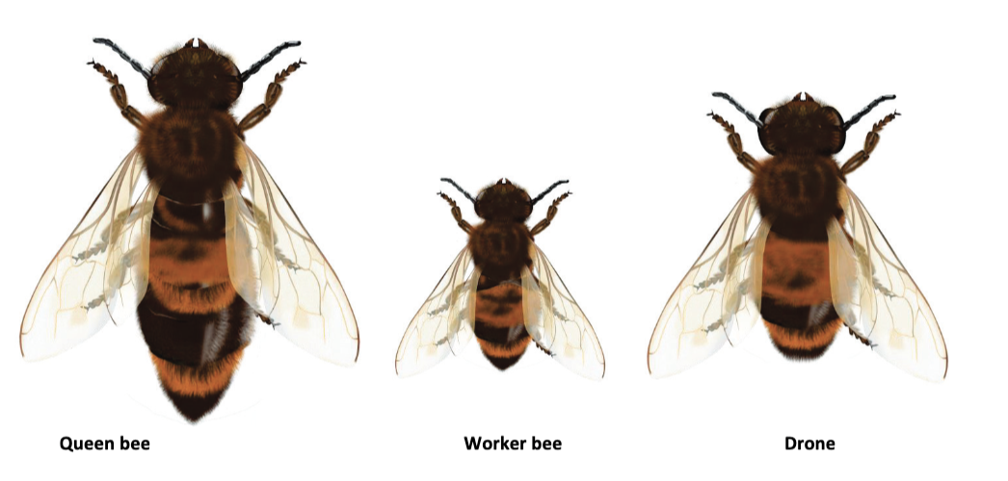
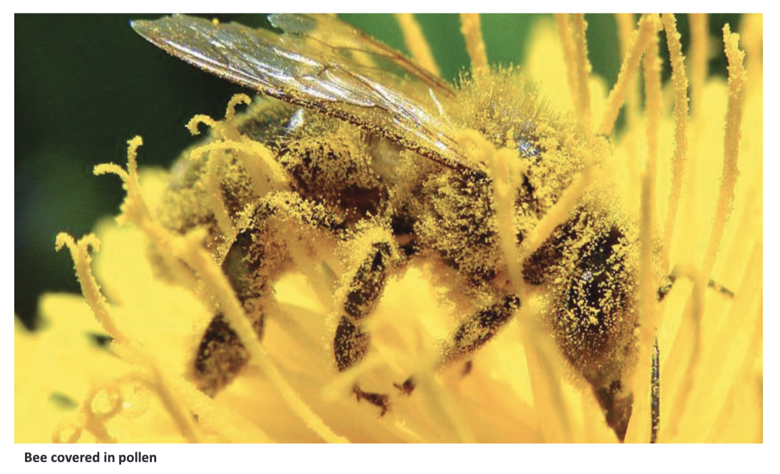
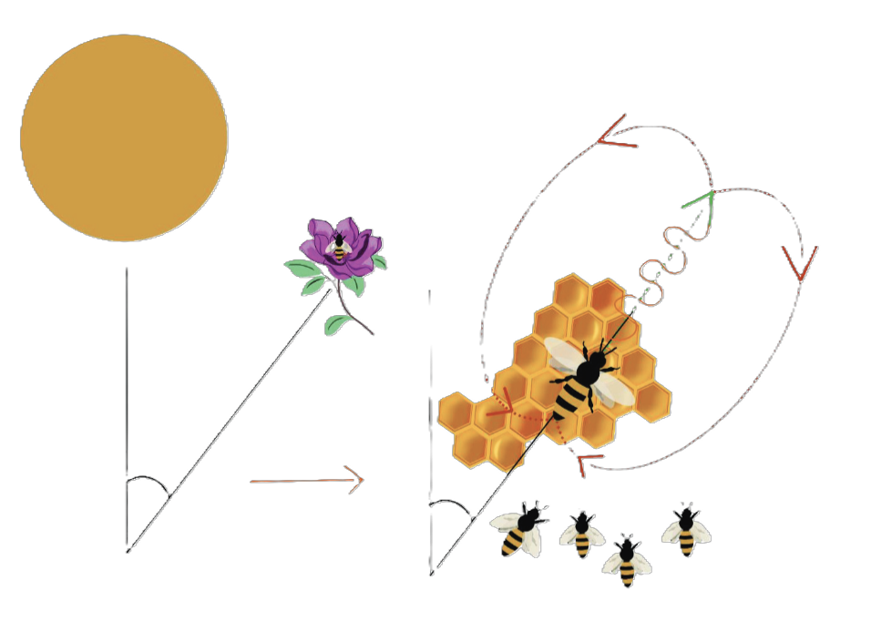
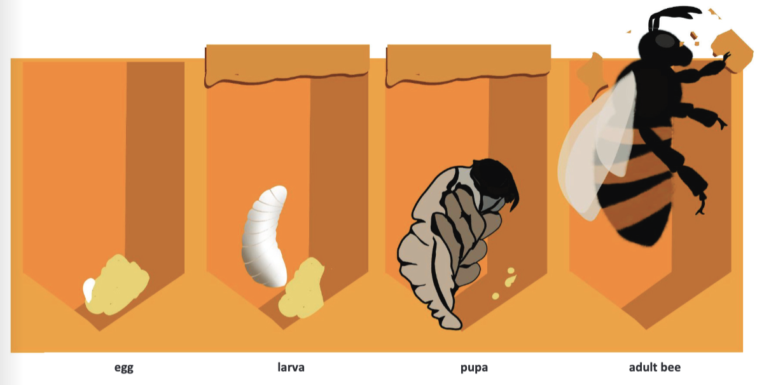








The Bee Project | Diamond | Science | Summer 2
What I should already know:
Plants have roots, stems, leaves and flowers.
Flowers help plants reproduce
Animals need food for energy
What I will learn:
LO 1: What is a bee?
LO 2: What is inside a hive?
LO 3: What do bees make?
LO 4: How do bees communicate?
LO 5: Who makes honey?
LO 6: What is happening to bees?
Key vocabulary:
colony | A large group of bees living together.
drone | Male bees whose job is to mate with the queen.
hive | The home of a bee colony.
nectar | Sweet liquid from flowers.
pollen | Powder from flowers used as food.
pollination | When pollen moves from one flower to another.
propolis | Sticky substance bees use to seal the hive.
queen | The only bee that lays eggs.
royal jelly | Special food for larvae and the queen.
sting | Sharp point on body used for defence,.
venom | Poison released when a bee stings.
waggle dance | A movement pattern bees use to communicate
worker bee | Female bees that collect food and look after the hive
Scientists/Inventors:
Karl von Frisch Discovered the waggle dance, showing how bees communicate
Johann Dzierzon (1643 - 1727) Developed early modern beekeeping techniques, helping people understand hive structure and bee behaviour

