Slide 1




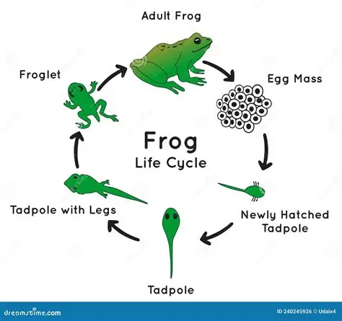

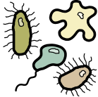

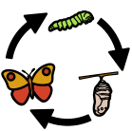
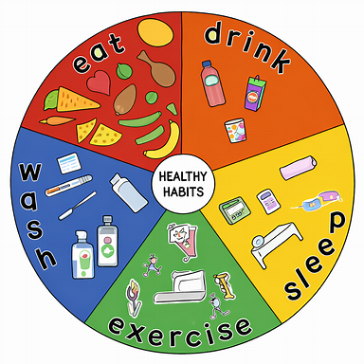

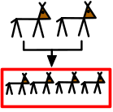





Growing up and keeping healthy | Sapphire | Science | Summer 2
What I should already know:
Living things need food, water and air to survive
Humans have body parts that help them do different things
Animals grow and change as they get older
We keep ourselves safe and healthy by washing hands, eating well and sleeping
What I will learn:
LO 1: What do animals need to survive?
LO 2: How do baby animals grow?
LO 3: What is a life cycle?
LO 4: How do humans grow?
LO 5: Why do we need to eat well?
LO 6: Why are exercise and hygiene important?
Key Vocabulary:
adult |  | A fully grown human or animal
balanced diet |  | Eating the right amounts of different foods
child |  | A young human between a toddler and teenager
exercise |  | Moving your body to stay fit and strong
germs |  | Tiny things that make us ill
hygiene |  | Keeping clean to stop germs spreading
life cycle |  | The stages of growing and changing
nutrition |  | How food helps our bodies grow and stay healthy
offspring |  | A baby animal or young living thing
survival |  | Staying alive by having food, water and air

