Slide 1
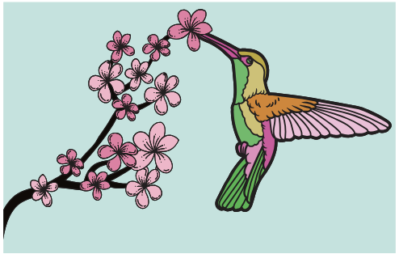
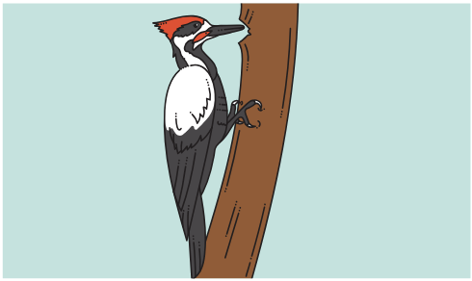
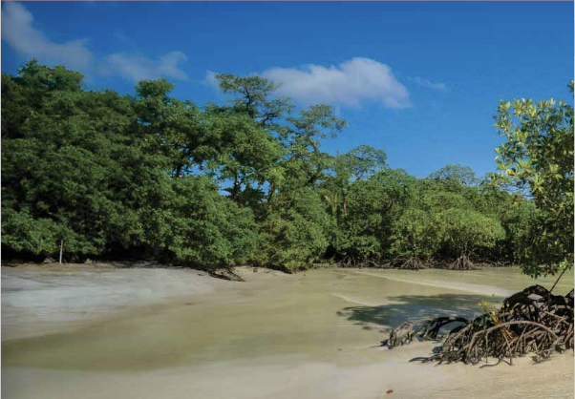

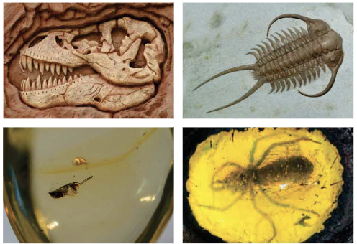





Evolution and Inheritance | Emerald | Science | Spring 2
What I should already know:
Living things have basic needs and characteristics and can be classified.
Animals and plants have life cycles and reproduce.
Organisms have adaptations to help them survive.
Offspring resemble their parents but are not identical.
What I will learn:
LO 1: What is variation?
LO 2: Why do adaptations matter?
LO 3: What are some animal adaptations?
LO 4: How do plants adapt?
LO 5: What can fossils reveal?
LO 6: Who are key figures in evolution?
Key Vocabulary:
adaptation | A feature that helps an organism survive.
camouflage | An adaptation that helps an organism blend in.
evolution | Gradual change in a species over long periods of time.
fossils | Remains or traces of ancient living things.
genes | Instructions passed from parents to offspring.
natural selection | The process where organisms best suited to their environment survive and reproduce.
offspring | The young produced by parents.
reproduction | The process of making more living things.
species | A group of living things that can reproduce together.
variation | Differences between individuals of the same species.
Scientists/Inventors:
Charles Darwin (1809 – 1882) Proposed the theory of natural selection after studying species around the world.
Alfred Russel Wallace (1823 - 1913) Developed the theory of natural selection.
Mary Anning (1799 - 1847) A pioneering fossil hunter who helped scientists understand prehistoric life.

