Slide 1
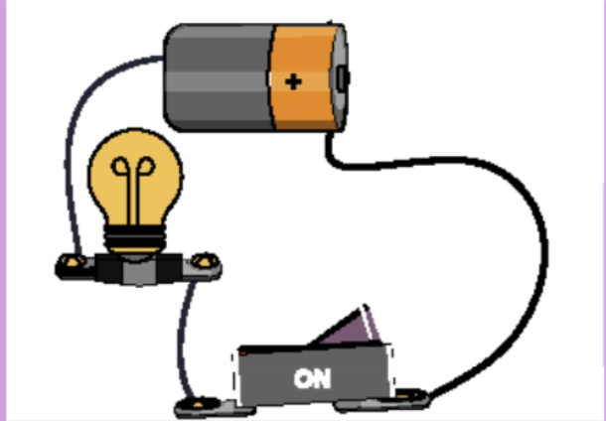
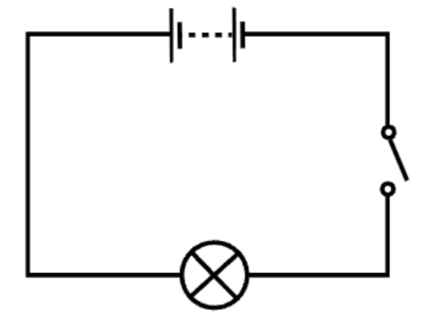
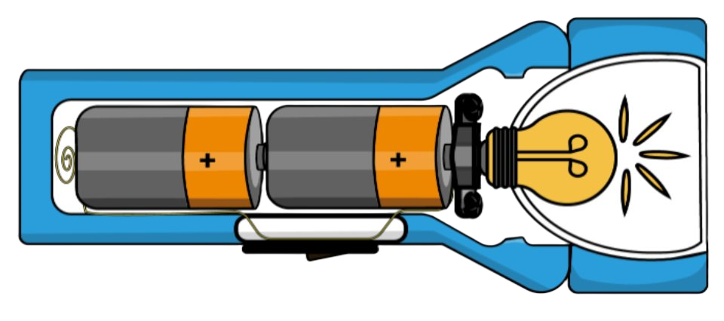


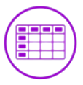


Electric Circuits | Emerald | Science | Spring 1
What I should already know:
Electricity is a type of energy that powers many everyday devices.
Identify items that use electricity and sort them.
Know the different materials that are conductors and insulators
What I will learn:
LO 1: How do electrical appliances work?
LO 2: Why do batteries have voltage?
LO 3: What are the parts of a circuit?
LO 4: What are circuit diagrams?
LO 5: How can we use electricity safely?
LO 6: What is the history of electricity?
Key Vocabulary:
circuit | A closed path that electricity can flow around.
component | A part of an electrical circuit.
electrical engineers | People who design, build and fix electrical systems and devices.
electric shock | A sudden jolt you feel if electricity passes through your body.
insulator | A material that does not let electricity pass through it.
surge protector | A device that protects electrical equipment from sudden bursts of extra electricity.
switch | A device that opens or closes a circuit.
Scientists/Inventors:
Alessandro Volta (1745–1827) He was an Italian scientist who invented the first battery, called the voltaic pile. His discovery helped people understand how electricity can flow in a circuit, and the unit “volt” is named after him.
Thomas Edison (1847–1931) An American inventor known for creating the first electric light bulb and helping develop electrical power systems.

