Slide 1
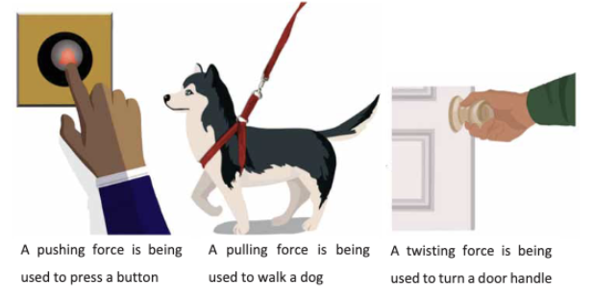
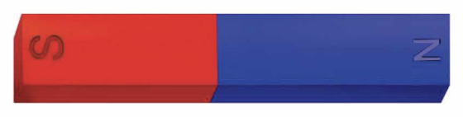
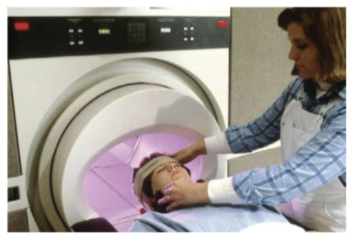




Forces and Magnets | Diamond | Science | Summer 1
What I should already know:
Objects can move in different ways.
A push or a pull can make an object move.
We use forces every day when we move, lift or push objects.
What I will learn:
LO 1: What do we mean by a force?
LO 2: How do pushes and pulls affect movement?
LO 3: What happens when forces are balanced or unbalanced?
LO 4: What is friction and how does it affect movement?
LO 5: How do magnets work?
LO 6: Which materials are magnetic and which are not?
Key Vocabulary:
attract | To pull objects towards each other.
friction | A force that slows movement between two surfaces that are touching.
force | A push or pull.
magnet | An object that attracts some metals.
magnetic | A material that is attracted to a magnet.
movement | When an object changes position.
non-magnetic | A material that is not attracted to a magnet.
pull | A force that moves something towards you.
push | A force that moves something away from you.
repel | To push objects away from each other.
Scientists/Inventors:
Ancient Chinese Inventors Early inventors discovered the lodestone could be used as a compass. This helped people understand magnetism and navigate long distances.
Sir Isaac Newton (1643 - 1727) A scientist who helped explain how forces affect movement. His ideas help us understand why objects move, stop or change direction

