Slide 1
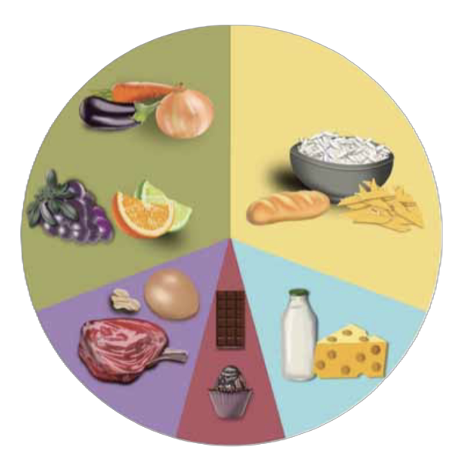
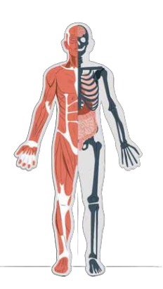




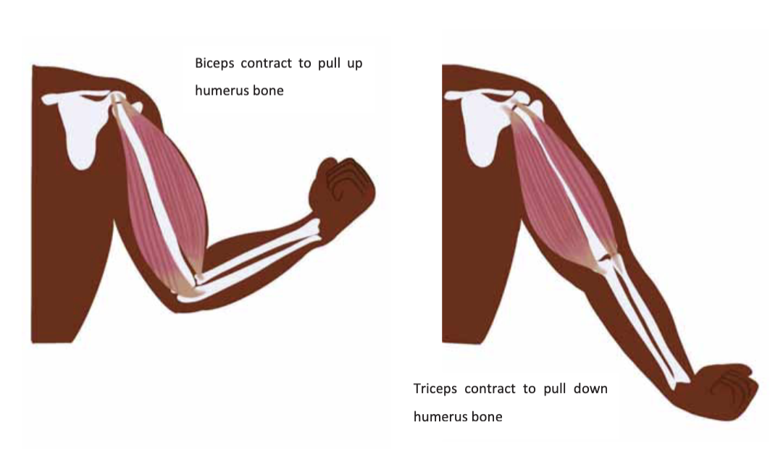




Animals including humans | Diamond | Science | Spring 2
What I should already know:
Animals need food, water, air and shelter to survive
Humans need a balanced diet and regular exercise
Living things depend on each other through simple food chains
What I will learn:
LO 1: How do living things get energy?
LO 2: What nutrients do we need?
LO 3: What do different animals eat?
LO 4: What are the bones in the body?
LO 5: How do skeletons differ in other animals?
LO 6: How do muscles help animals move?
Key Vocabulary:
carnivore | An animal that mostly eats meat
collagen | A protein that helps bones stay strong and flexible
consumer | A living thing that eats other plants or animals
exoskeleton | A hard outer covering that protects some animals
fibre | Helps the digestive system work properly
fracture | A break or crack in a bone
herbivore | An animal that eats plants
hibernate | When an animal rests for a long time to save energy
muscle | Soft tissue that helps the body move
omnivore | An animal that eats both plants and animals
pescatarian | A person who eats fish but not meat
producer | A living thing (like a plant) that makes its own food
vegan | A person who eats no animal products
vegetarian | A person who does not eat meat
Scientists/Inventors:
Dr Stephen Hawking (1942 – 2018) Although he wasn’t a biologist, he was so curious about how science helps us to understand the world and our bodies
Common mistakes!
Plants ‘eat’ foods like animals
All carnivores eat only meat
All fats are unhealthy
Only mammals have muscles

