Slide 1
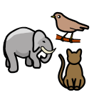
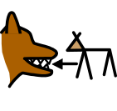
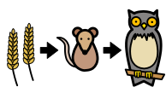
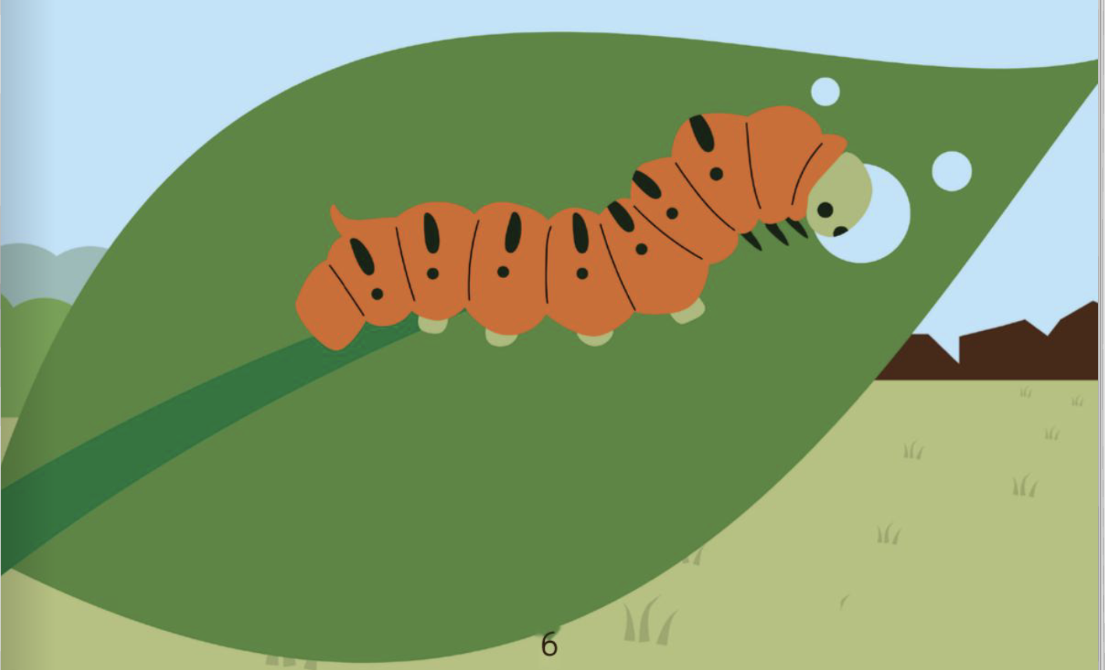

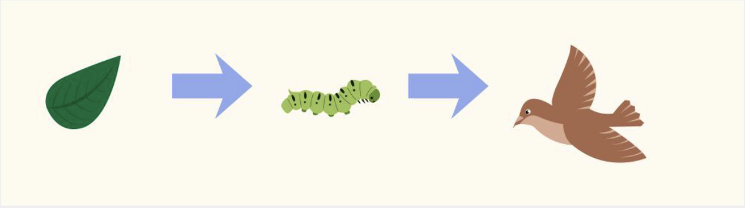

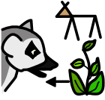
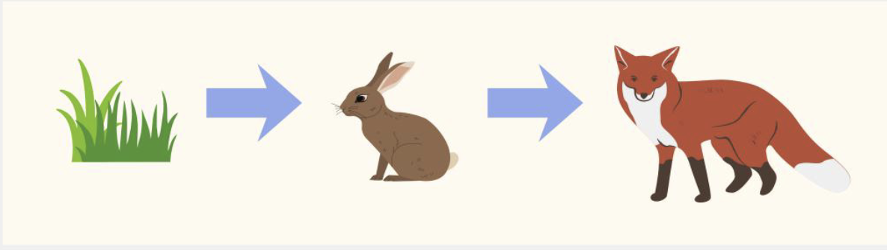
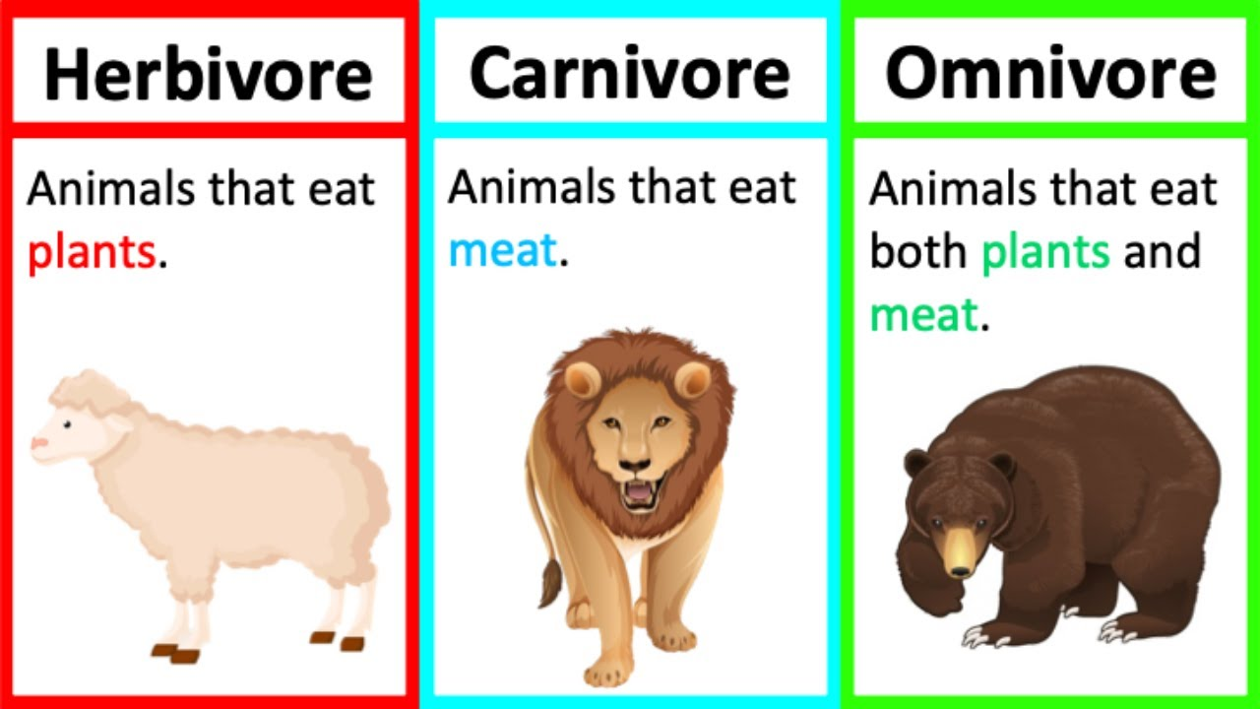
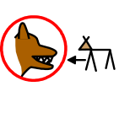



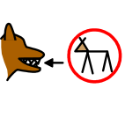

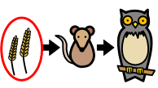
Food Chains | Sapphire | Science | Summer 1
What I should already know:
Animals need food to stay alive
Animals and plants are living things
Animals live in habitats that suit them
What I will learn:
LO 1: What do animals eat?
LO 2: Where does our food come from?
LO 3: What is a food chain?
LO 4: What do the arrows in a food chain mean?
LO 5: How are humans part of food chains?
LO 6: What happens if a food chain is broken?
Key Vocabulary:
animal |  | A living thin that eats plants or other animals
carnivore |  | An animal that eats other animals
food chain |  | Shows how food moves from one living thing to another
habitat |  | The place where a living thing lives
herbivore |  | An animal that eats plants
omnivore |  | An animal that eats plants and animals
predator |  | An animal that eats another animal
prey |  | to find out how tall, long or heavy something is
producer |  | A plant that makes its own food.

