Slide 1



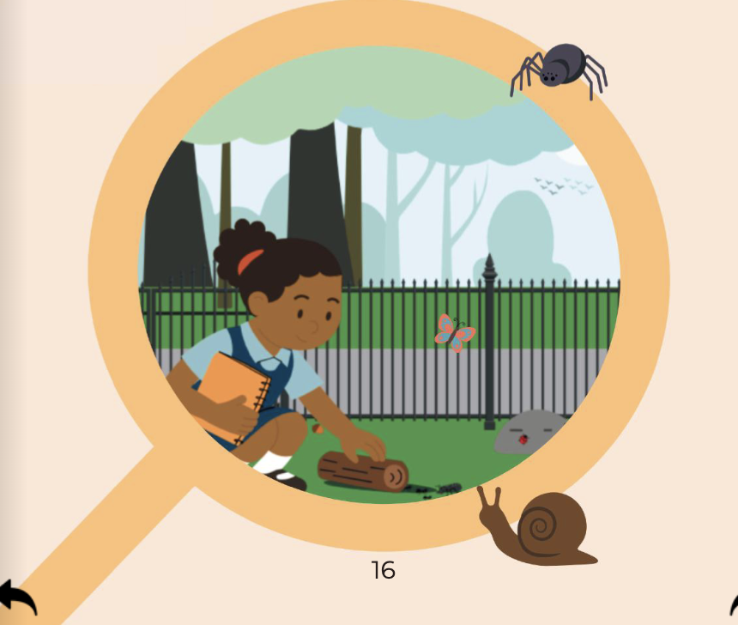

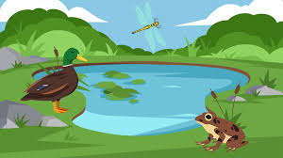


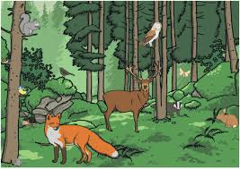






Habitats | Sapphire | Science | Spring 2
What I should already know:
Living things can be living, dead or never alive
Animals need food, water, air and shelter to survive
Plants need light, water and the right temperature to grow
Weather and seasons change throughout the year
What I will learn:
LO 1: What is a habitat?
LO 2: What plants and animals live near us?
LO 3: What is a microhabitat?
LO 4: How do habitats mean needs?
LO 5: How do living things depend on each other?
LO 6: Can we compare different habitats?
Key Vocabulary:
adapt |  | To change to survive in a habitat
conditions |  | What a habitat is like (hot, cold, wet, dry)
environment |  | The surroundings where a living thing lives
habitat |  | A place where a plant or animal lives
microhabitat |  | A very small habitat, like under a log or a stone
organism |  | A living thing
shelter |  | A safe place to live
variety |  | A range of different living things

