Slide 1
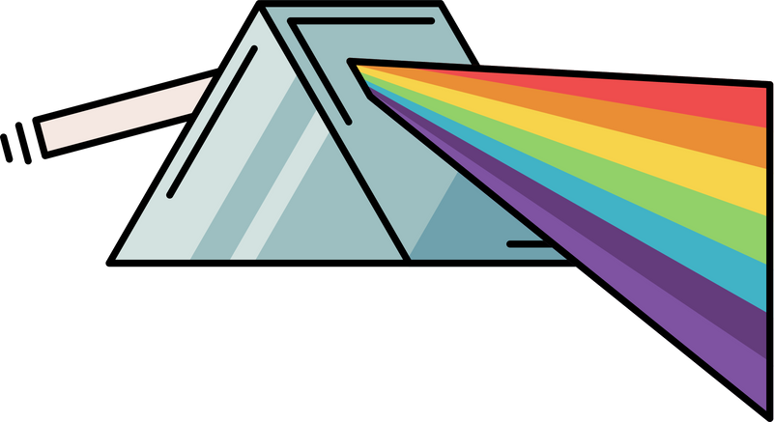

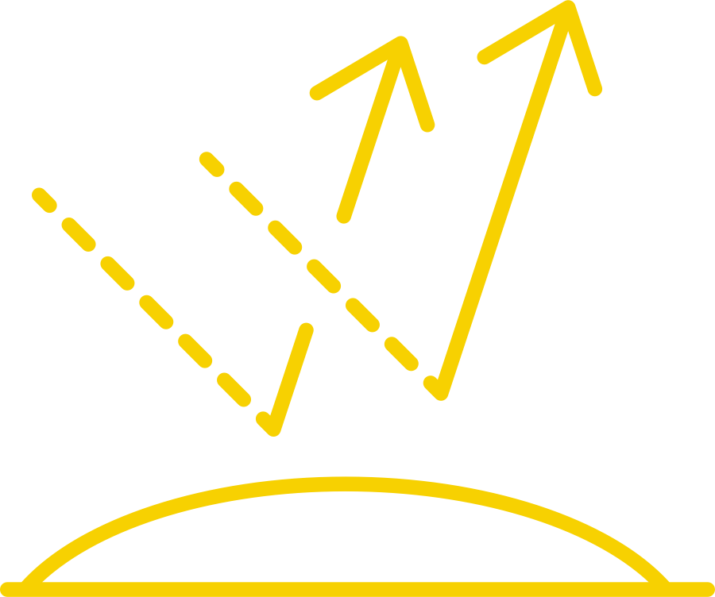





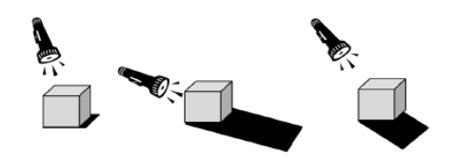
Light | Emerald | Science | Autumn 2
What I should already know:
Light comes from sources and that darkness is the absence of light
Light can be reflected and blocked, creating reflections and shadows
Understand how light behaves throughout the day
What I will learn:
LO 1: How does light travel?
LO 2: How does reflection help us see?
LO 3: Can we increase reflection?
LO 4: What shapes our shadows?
LO 5: What causes rainbows?
LO 6: Can we make a red apple blue?
Key Vocabulary:
absorb | When something takes in light, heat, or sound instead of bouncing it back.
distort | To change the shape or appearance of something so it looks different or unclear.
opaque | A material that does not let any light through.
periscope | A tool that uses mirrors to help you see over or around something.
rays | Straight lines that show the path light travels.
transparent | A material that lets light pass through clearly, so you can see it easily.
translucent | A material that lets so light through, but not clearly. You can’t see through it properly.
Scientists/Inventors:
Euclid (300BC – 270BC) One of the first to describe how light travels in straight lines creating shadows.
Isaac Newton (1642 - 1727) Discovered that white light is made up of many colours using prisms.

