Slide 1

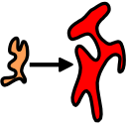



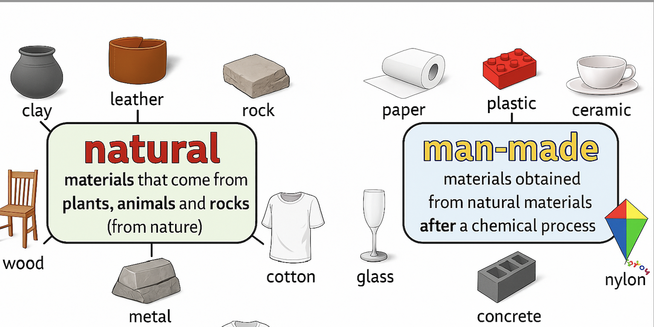
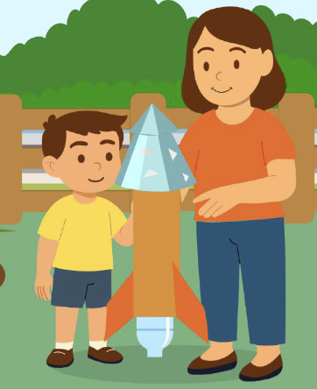


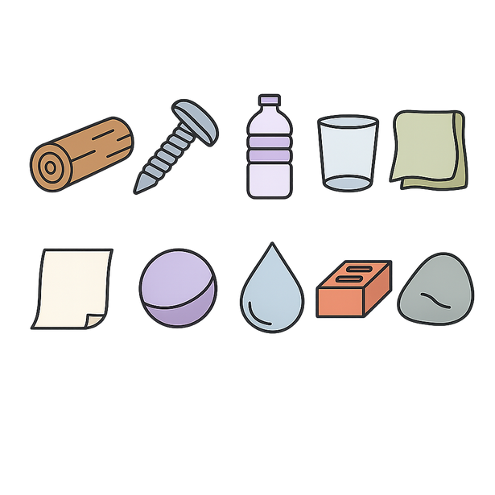







Uses of everyday materials | Sapphire | Science | Autumn 2
What I should already know:
Know that objects are made from different materials
Describe the basic properties of materials
Recognise that different properties affect how an object is used
What I will learn:
LO 1: What material is best for this job?
LO 2: What is the best waterproof material?
LO 3: Can objects be made from different materials?
LO 4: How can squashing change a shape?
LO 5: How does bending or twisting change things?
LO 6: How can we make things longer?
Key Vocabulary:
absorbent |  | Soaks up liquid easily
change |  | To make something different.
flexible |  | Can bend or twist without breaking.
material |  | What something is made from.
measure |  | To find out how big, long or heavy something is.
object |  | A thing you can see and touch.
shape |  | The way something looks on the outside.
suitable |  | Just right for a job or purpose.
waterproof |  | Keeps water out and doesn’t get wet.

