Slide 1


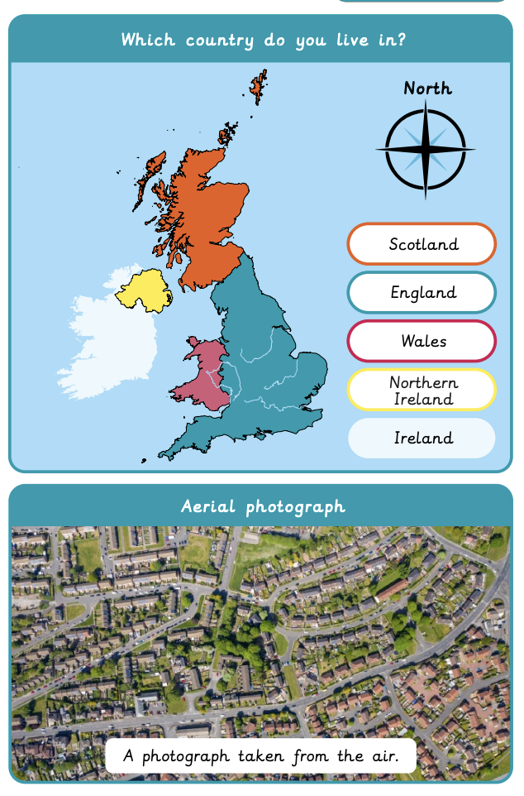

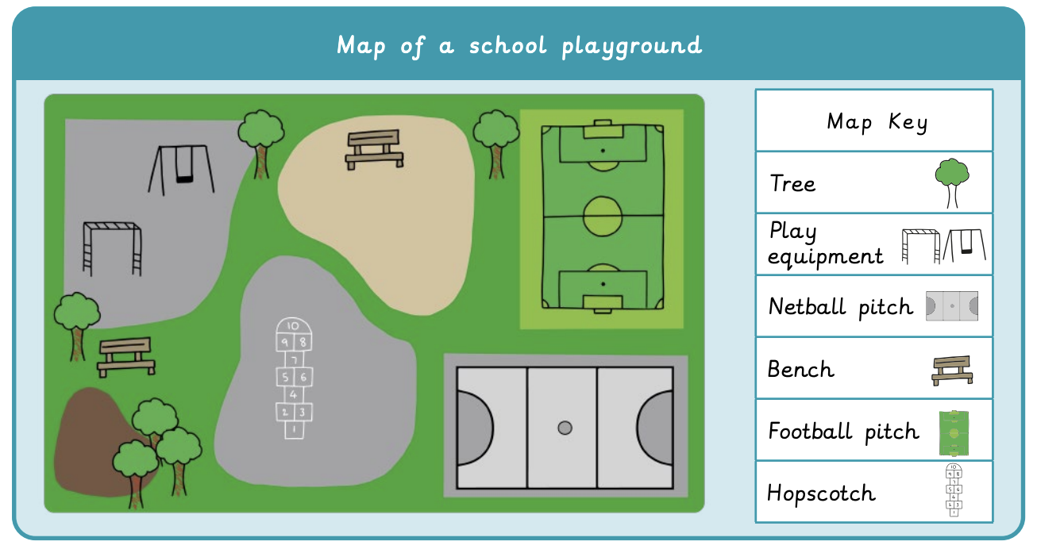

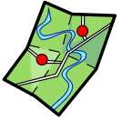

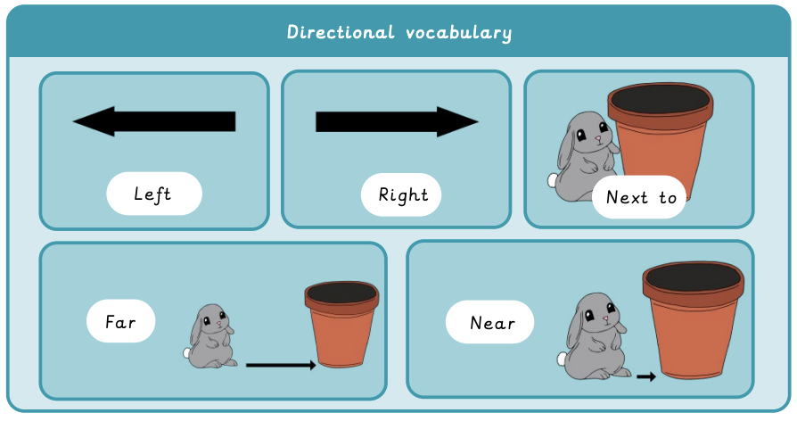


What is it like here? | Sapphire Year A | Geography | Autumn
What I should already know:
Describe what I can see, hear and feel outside.
Know the differences between home and school
What I will learn:
LO 1: Where in the world are we?
LO 2: What can we see in our classroom?
LO 3: What can we find in our school grounds?
LO 4: Where are the different places in our school?
LO 5: How do we feel about our playground?
LO 6: Can we make our playground even better?
Key Vocabulary:
aerial photograph |  | A photograph taken from the air
distance |  | The space between two points
features |  | Important objects on a map
key |  | A list of symbols on a map that explain what each symbol is
map |  | A picture of a place, drawn from above
place |  | A particular location
survey |  | A set of questions to gather people’s feelings
symbol |  | A mark that represents a feature on a map

