Slide 1

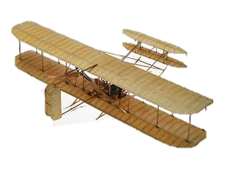

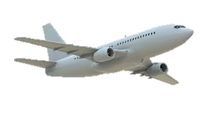


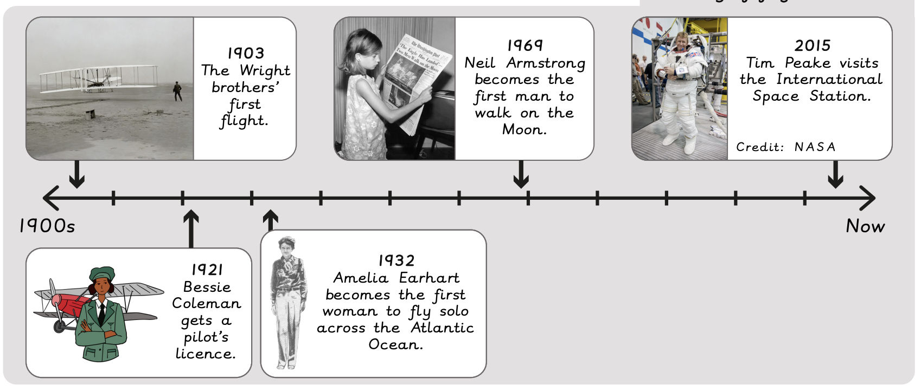



How did we learn to fly? | Sapphire Year A | History | Summer
What I should already know:
Know some similarities and differences between things in the past and now
Comment on images of familiar situations in the past
What I will learn:
LO 1: Who were the Wright Brothers?
LO 2: When was the first flight?
LO 3: Why is Bessie Coleman significant?
LO 4: Why is Amelia Earhart significant?
LO 5: Why was the Moon landing special?
LO 6: How did we learn to fly?
Key vocabulary:
beyond living memory |  | More than 100 years ago
flight |  | The action of flying through the air
inventor |  | Someone who makes something that has never been made before
lifetime |  | From birth to death
living memory |  | Events remembered by people who are still alive
past |  | Time that has already happened
present |  | Time happening now

