Slide 1


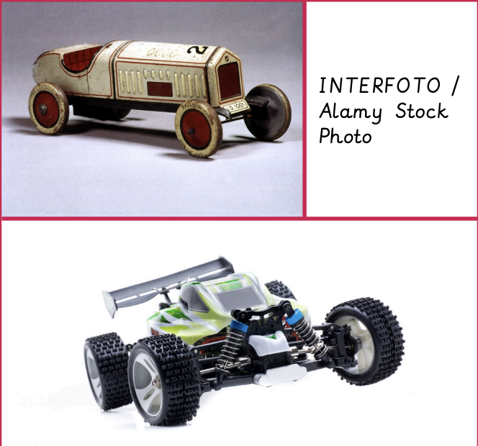


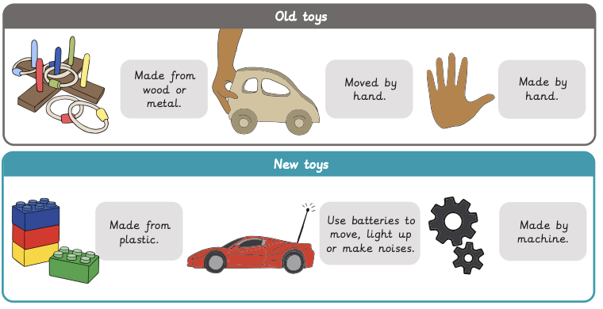


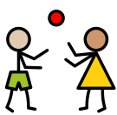
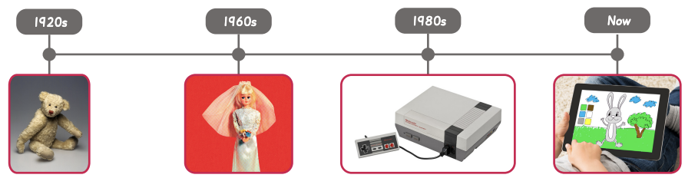

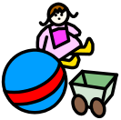
How have toys changed? | Sapphire Year A | History | Spring
What I should already know:
Know some similarities and differences between things in the past and now
Comment on images of familiar situations in the past
What I will learn:
LO 1: What is your favourite toy?
LO 2: Did your parents and grandparents play with the same toys as you?
LO 3: What were toys like in the past?
LO 4: What is similar and different about toys now and in the past?
LO 5: How have teddy bears changed over time?
LO 6: How have toys changed?
Key Vocabulary:
artefacts |  | Objects used by people in the past
century |  | A period of 100 years
grandparent |  | The parent of a father or mother
modern |  | Relating to present times
old |  | Belonging to the past
parent |  | A person’s father or mother
play |  | To take part in an activity for enjoyment
special |  | Something of value or meaning
toy |  | An object for a child to play with

